Slide 1
Pancreatic Function and Glucoregulation
Notes:
Talk about what the burnt orange slide means
To setup

Slide 2
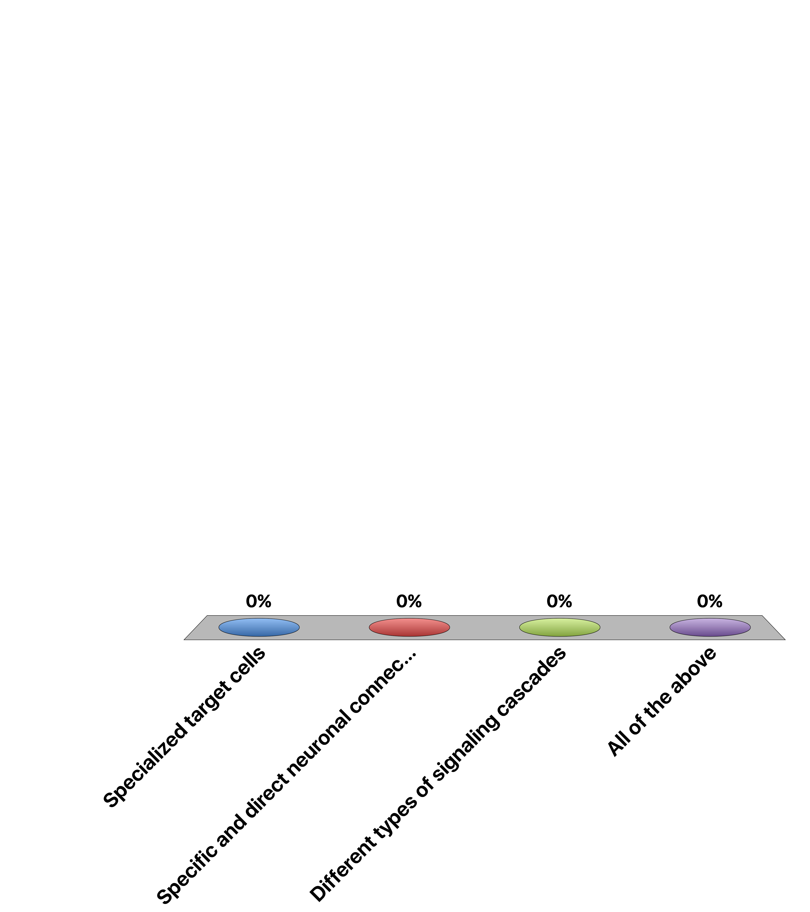
How Is Specificity Achieved in Hypothalamlic-Anterior Pituitary Signaling
Specialized target cells
Specific and direct neuronal connections
Different types of signaling cascades
All of the above
Response Counter
15

Slide 3
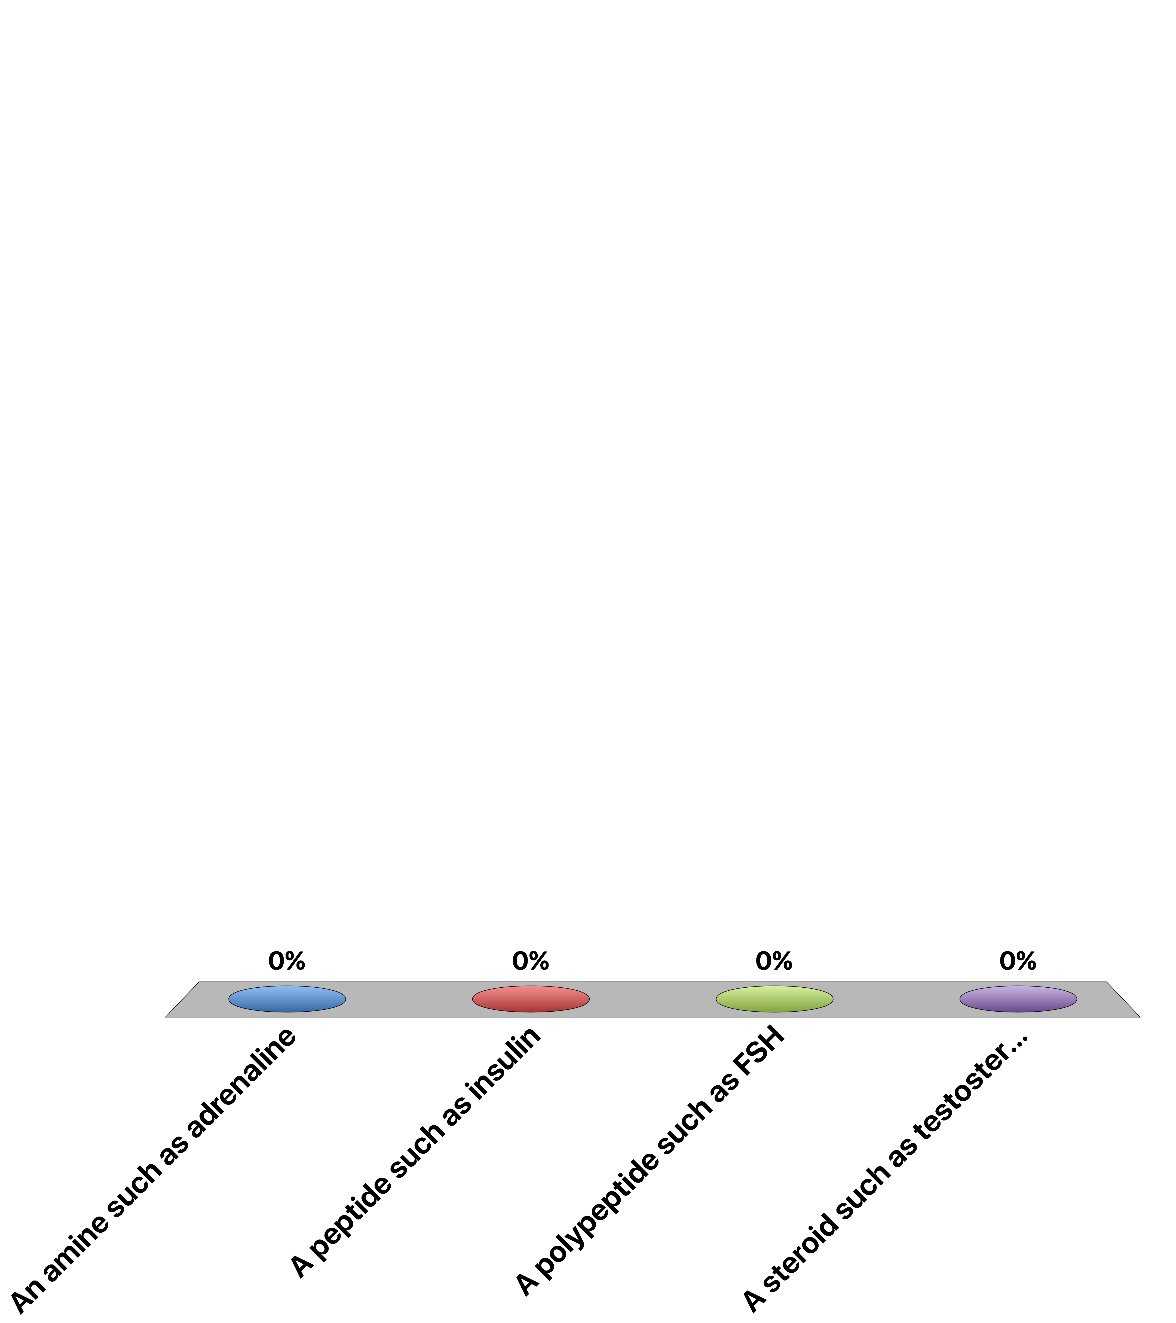
Which hormone type is most likely to be able to cross plasma membranes
An amine such as adrenaline
A peptide such as insulin
A polypeptide such as FSH
A steroid such as testosterone
Response Counter
15

Slide 4
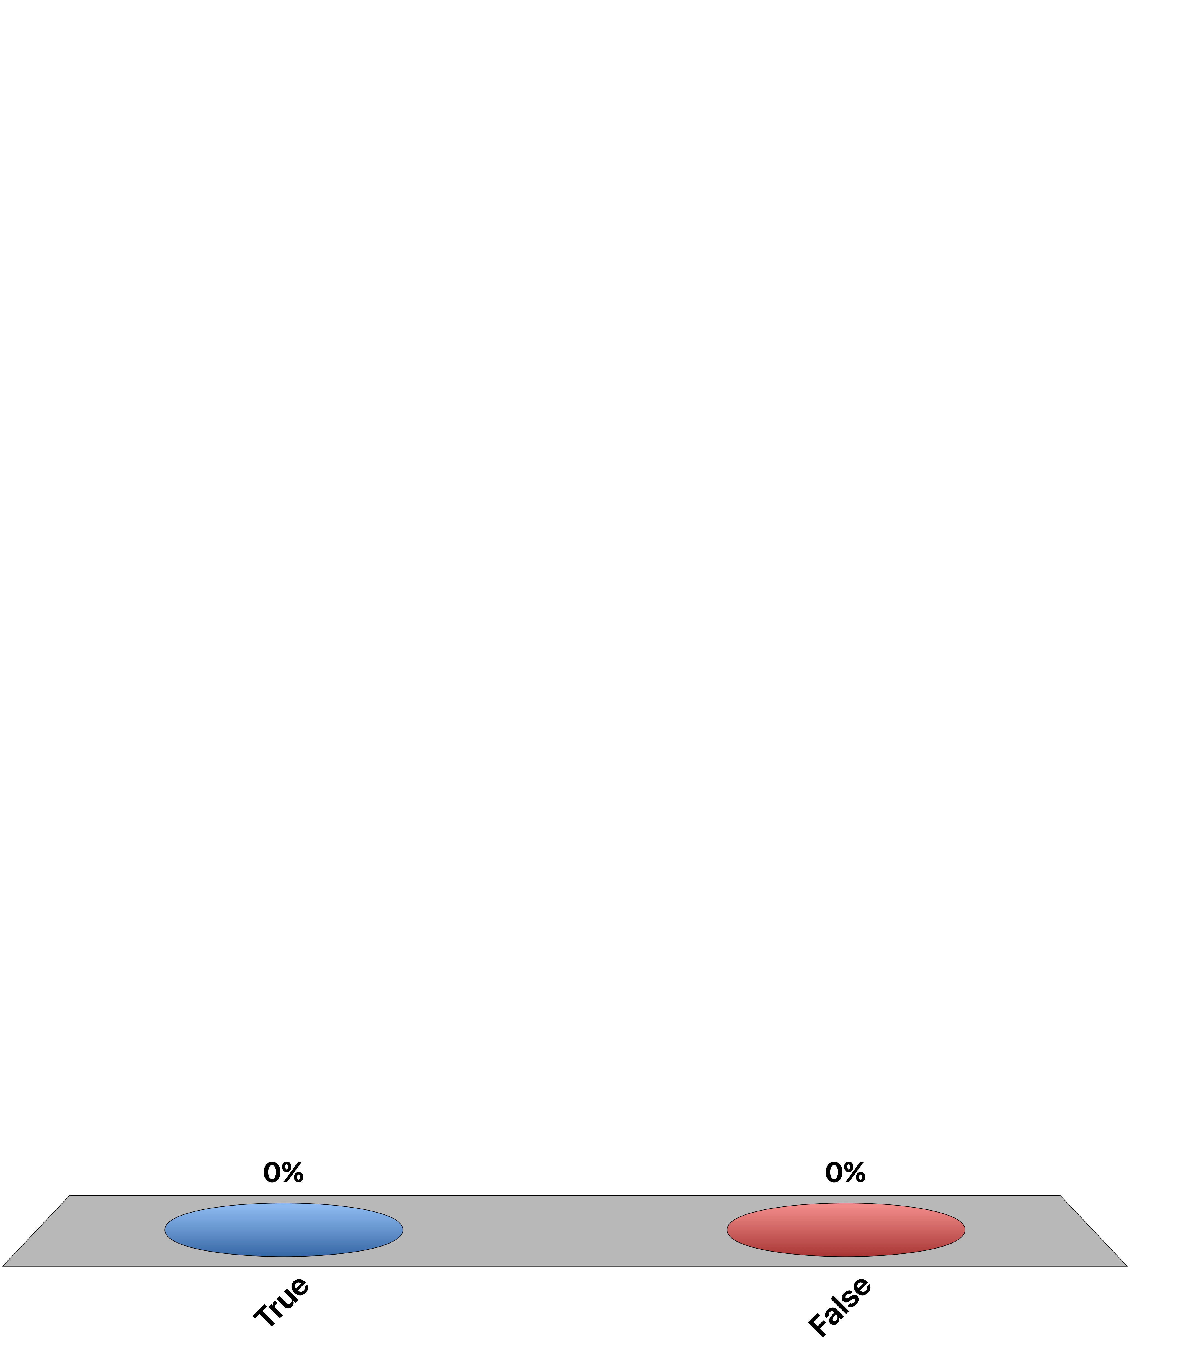
Can you recapitulate all the effects of GH by Providing IGF-1?
True
False
Response Counter
15
Notes:
Dual-effector hypothesis

Slide 5
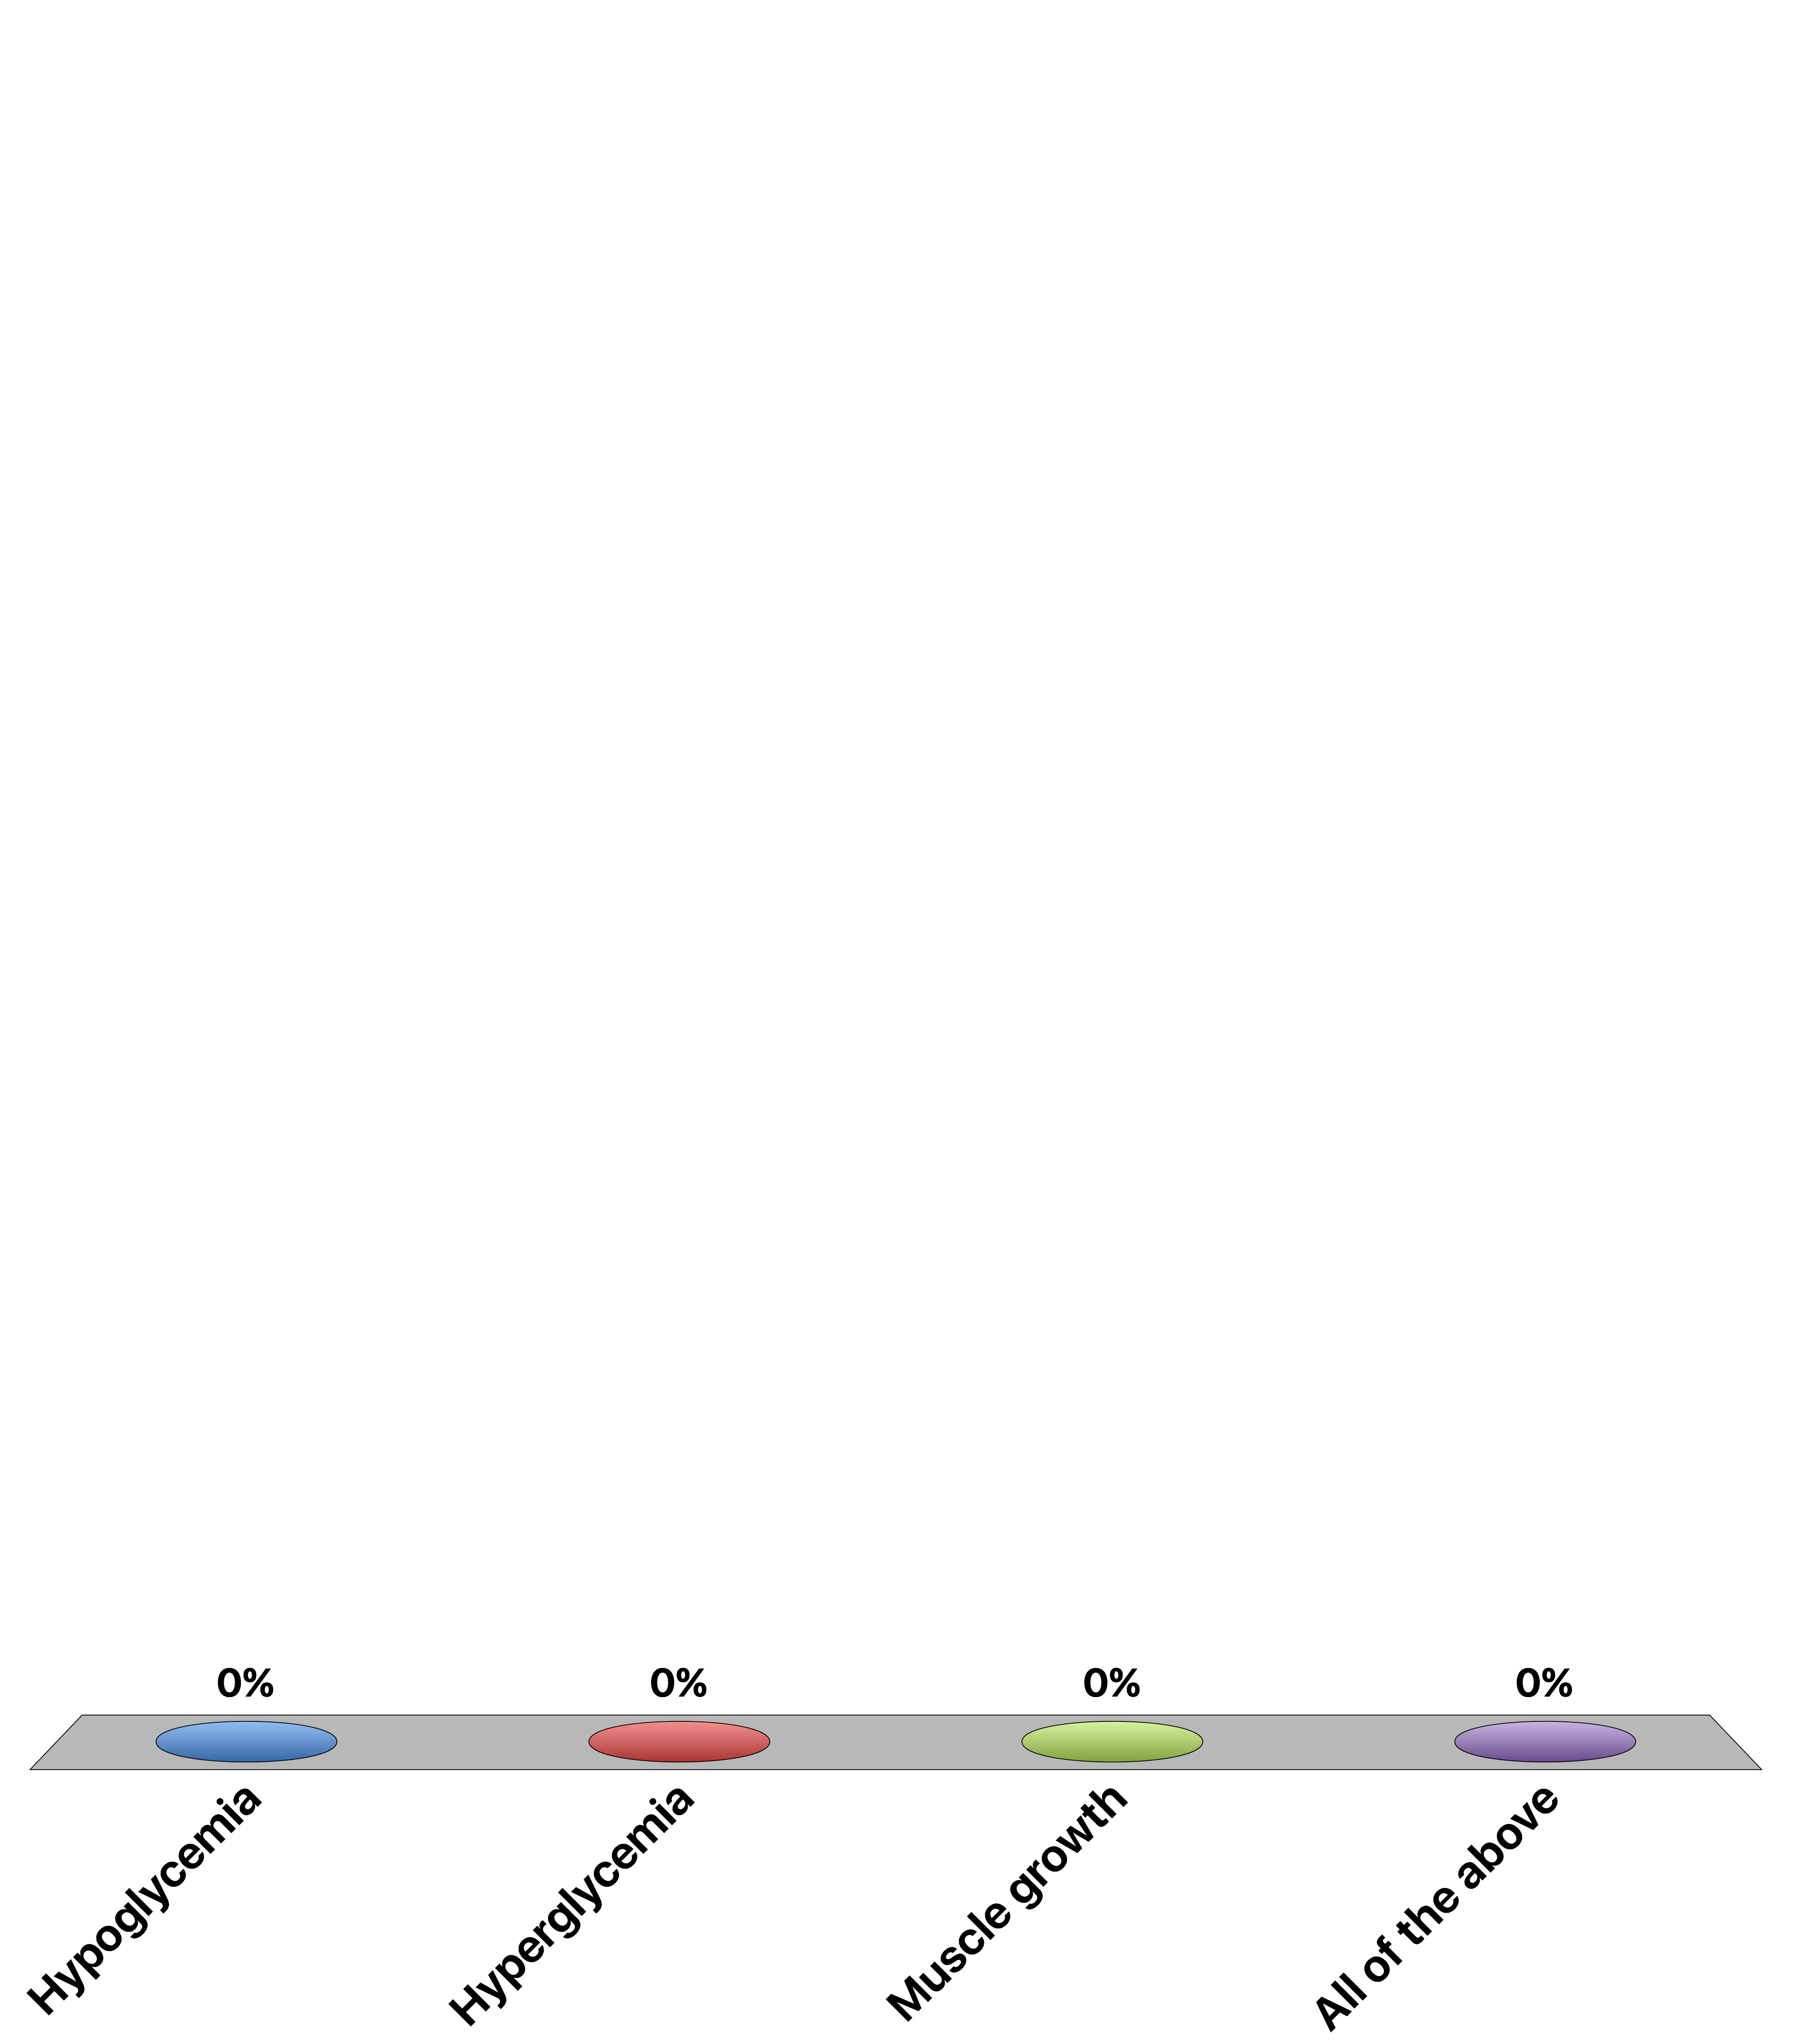
Chronically elevated glucocorticoid signaling would cause
Hypoglycemia
Hyperglycemia
Muscle growth
All of the above
Response Counter
15

Slide 6
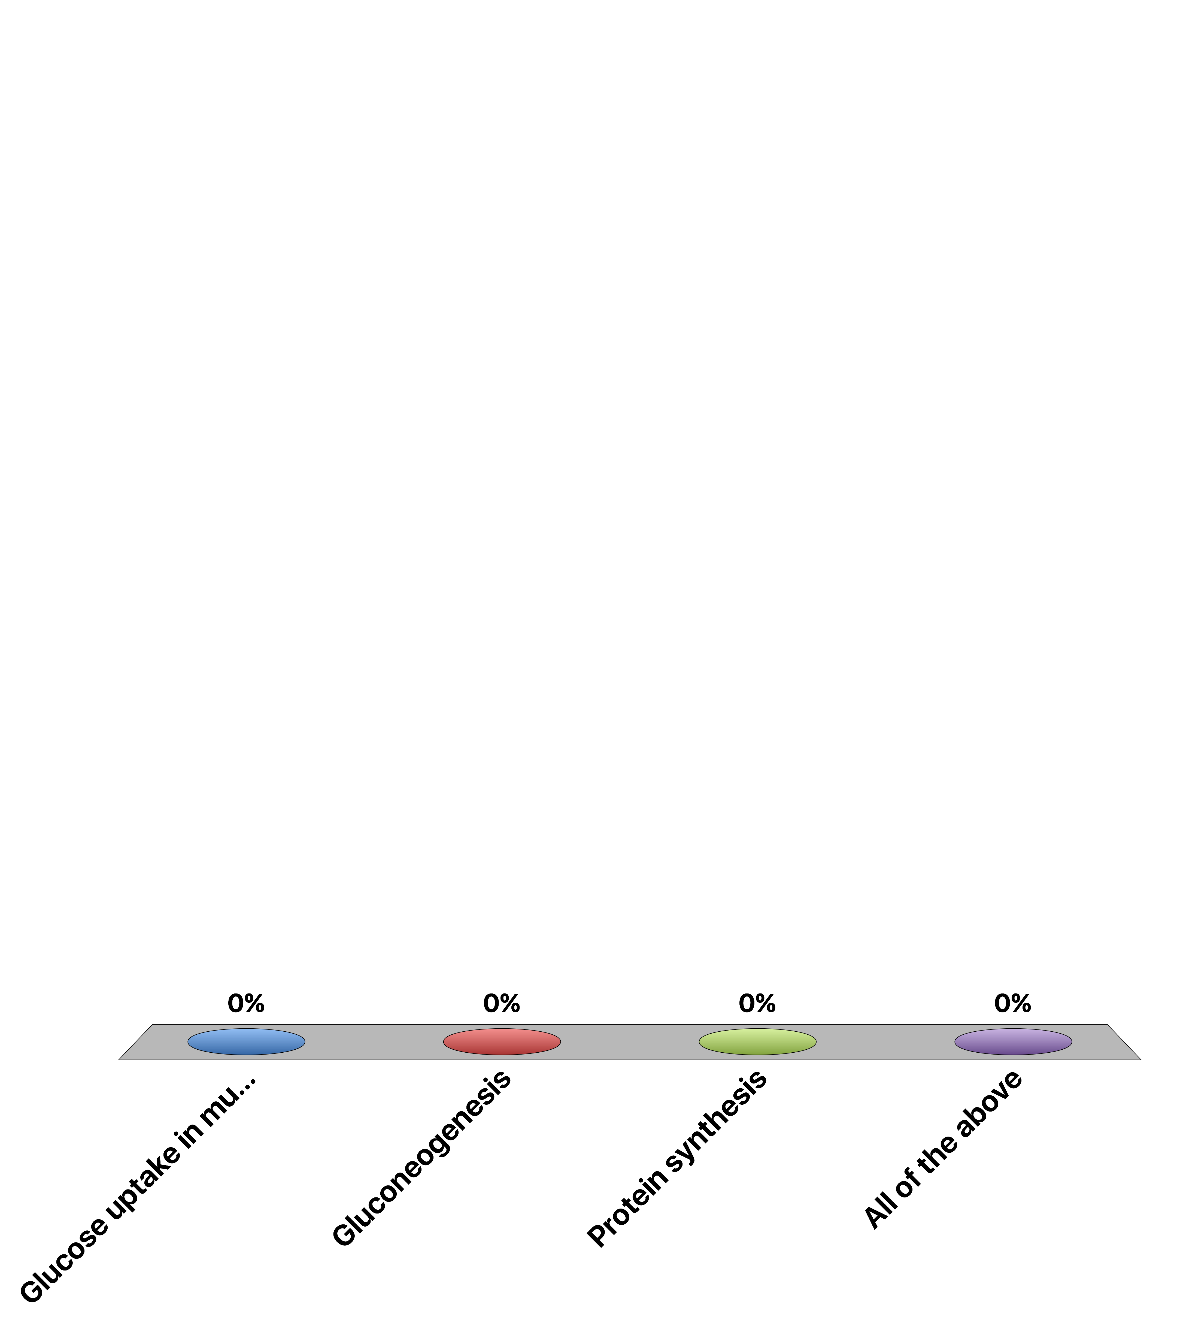
Which process does cortisol accelerate
Glucose uptake in muscle
Gluconeogenesis
Protein synthesis
All of the above
Response Counter
15

Slide 7
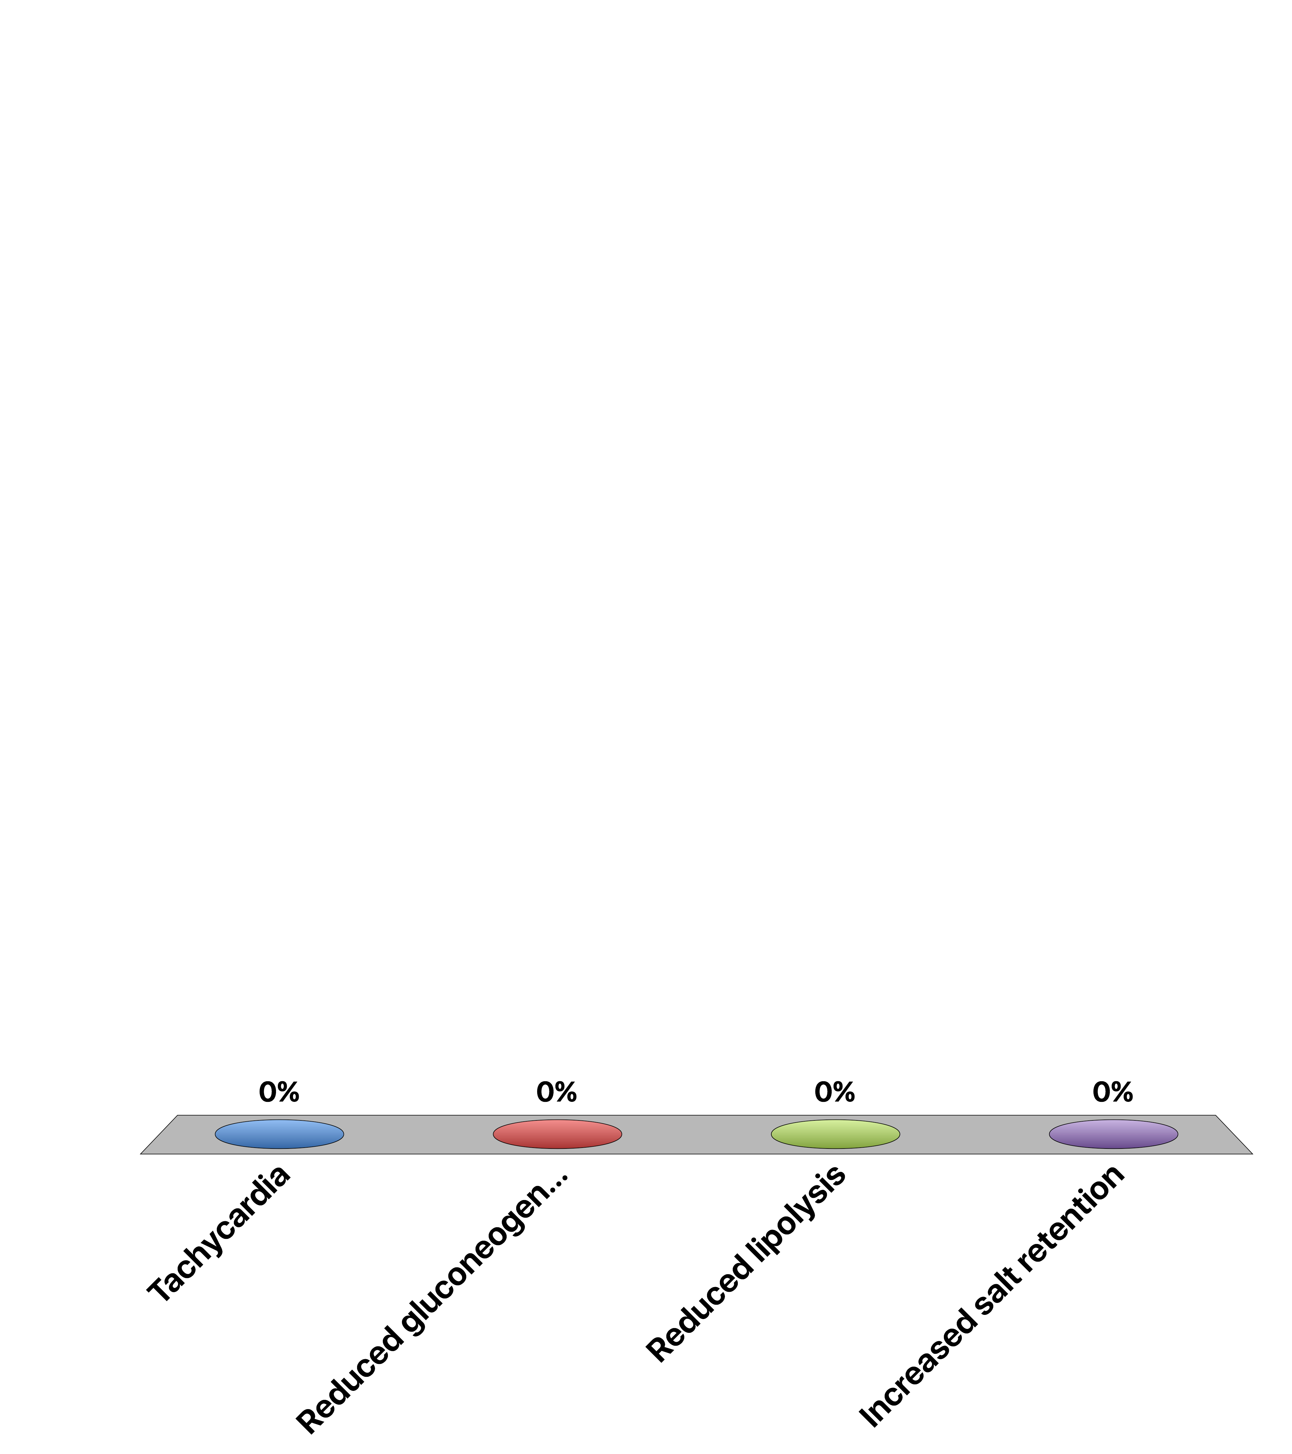
A patient has a pheochromocytoma, we expect that this the patient should have:
Tachycardia
Reduced gluconeogenesis
Reduced lipolysis
Increased salt retention
Response Counter
15

Slide 8
Learning Objectives
Name the cell types of the Islets of Langerhans and name the hormones secreted by them.
Describe the main targets and functions of glucagon.
List the major factors that stimulate or inhibit glucagon and insulin.
Describe the important physiological roles of insulin.
List the major actions of insulin in muscle, adipose tissue, and liver.
Explain briefly the mechanism of glucose uptake into the muscle.
Name the tissues in which insulin facilitates glucose uptake and those in which insulin does not facilitate glucose uptake.
List the major factors that stimulate or inhibit insulin secretion.
Draw an oral glucose tolerance test (oGTT) (glucose, insulin, and glucagon levels) and and describe what is occurring and why. Explain how the two hormones act to promote glucose homeostasis in the plasma.
State which nutrient storages are preferably used for short-term regulation of energy metabolism if no nutrients are available from the GI tract.
Discuss the hormones involved, fuel storage capacity, fuel storage consumption, and glucose (or fatty acid) levels during 1) the postprandial period, 2) the post-absorptive period, 3) fasting.
List the insulin-counteracting hormones and their roles in glucose homeostasis. Discuss the hormones involved in minute-to-minute regulation and long-term regulation of glucose homeostasis.

Slide 9
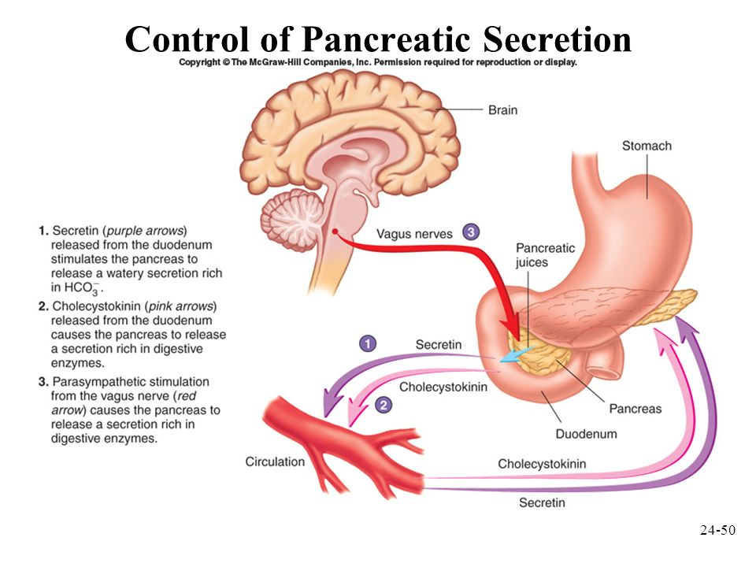
Notes:
Endocrine vs Exocrine

Slide 10
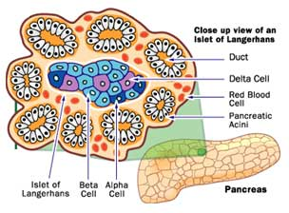
Pancreatic Anatomy
Cell | Hormone
Beta Cells | Insulin
Alpha Cells | Glucagon
Delta Cells | Somatostatin
Ductal Cells | Exocrine

Slide 11
Diabetes Mellitus
One of the first described diseases (1500 BC)
Named diabetes by Appolonius of Memphis (Egypt)
Diabetes (to pass through)
Mellitus (from honey)

Slide 12
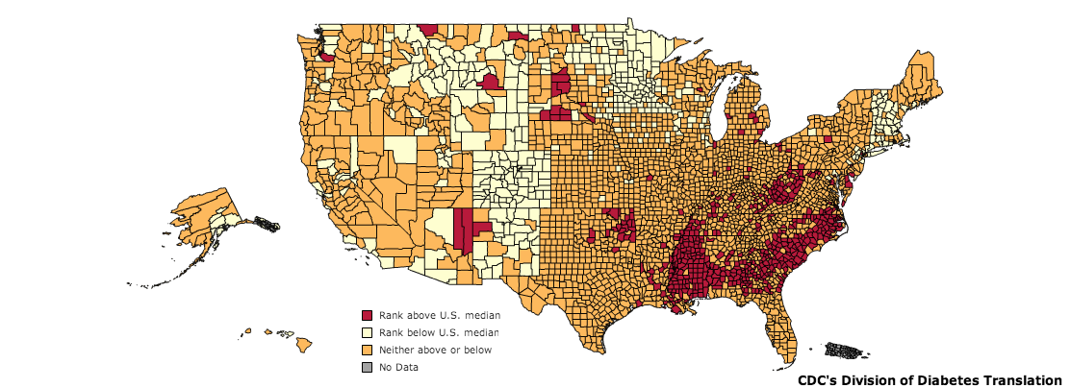
Diabetes in the United States
CDC, 2010
Notes:
As of 2011, diabetes affects 25.8 million people or 8.3% of the population. This includes approximately 7 million undiagnosed individuals. In addition to this, 79 million Americans over the age of 20 are estimated to be pre-diabetic. As of 2007, diabetes is estimated to cost $116 billion in direct and $58 billion in indirect costs [@CDC2011].
Diabetes is especially prevalent in this region. As shown in the map, there is a higher percentage of diabetics in the mid and deep south regions of the United States.

Slide 13
Complications of Diabetes
Retinopathy
Leading cause of blindness in 20-75 year olds
Nephropathy
30% to 40% of all diabetics are symptomatic
Neuropathy
risk of amputation >25 times greater than that of people without diabetes.
Cardiovascular
Heart Attack/Stroke Risk 2-4X with diabetes

Slide 14
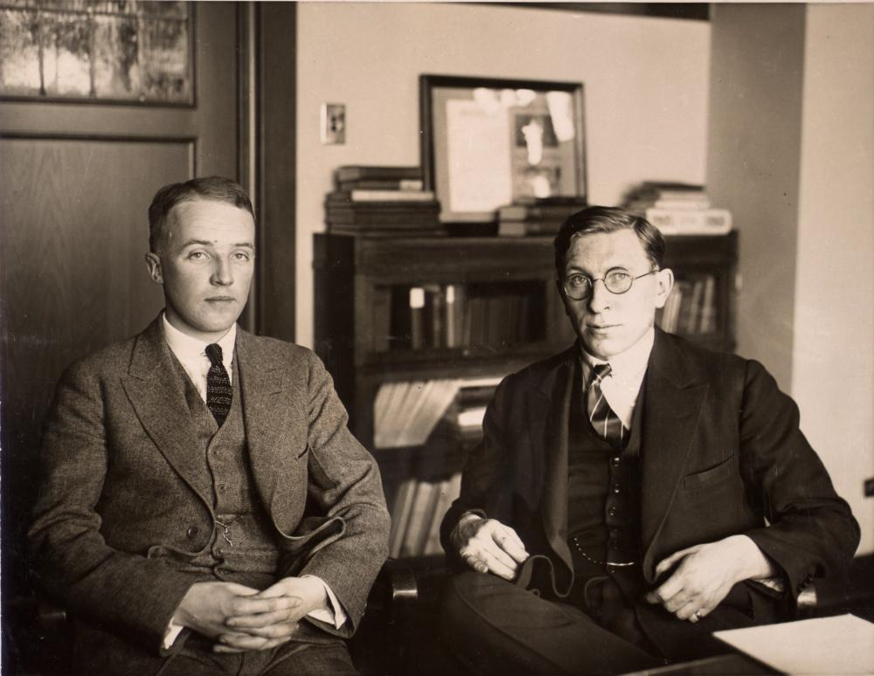
The Discovery of Insulin
Notes:
1889 von Mering and Minkowski (Pancreatectomy mimics disease)
Banting was a surgeon adept at pancreatectomizing dogs, Best was a lab technician who was very good at measuring blood glucose. MacLeod provided them lab space at the University of Toronto

Slide 15
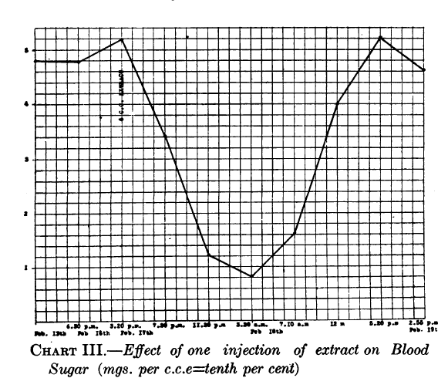
The Discovery of Insulin
Banting et al. 1922
Notes:
Insulin was discovered by Frederick Banting and his colleagues at the University of Toronto in 1921. They performed experiments in which they injected extracts
from pancreas fractions into dogs which had their pancreas’ surgically removed. They showed that a secreted substance from the pancreas lowered blood glucose
in these dogs (Frederick G. Banting and Best 1922). This is an image of dog pancreas isolate injected into a diabetic child

Slide 16
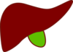

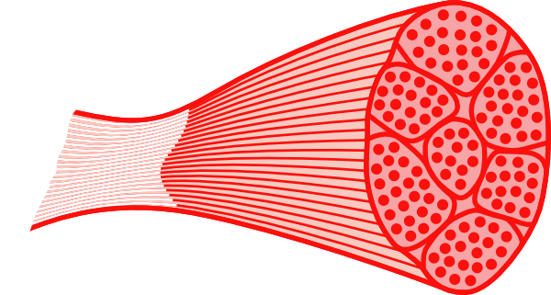
Regulation of Blood Glucose Levels
Gluconeogenesis
Disposal
Glucose Uptake
Glucose Storage
Glucose Utilization
Glucose Production
Glucose Uptake
Glucose Storage
and Utilization
Notes:
Ask for some examples of how glucose is stored, or how it is utilized

Slide 17
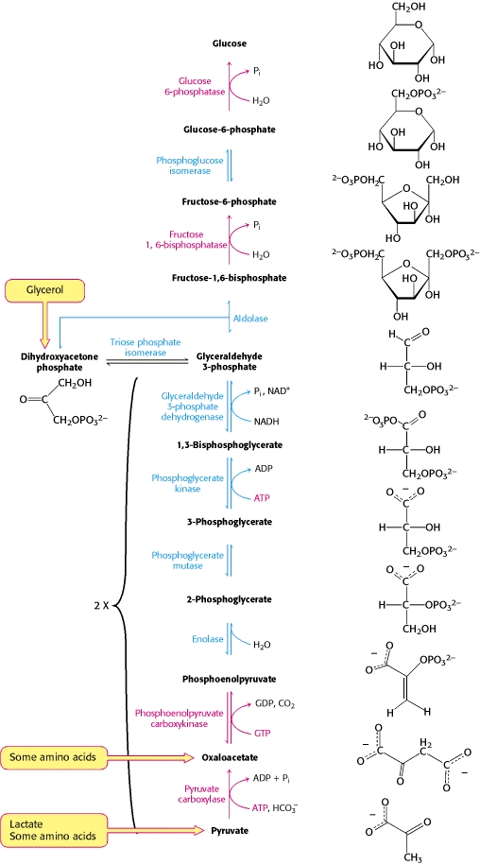
Gluconeogenesis
Uses amino acids and fatty acids to generate glucose
Key enzymes are PEPCK, FBPase and G6Pase
Notes:
Where does this mainly occur

Slide 18
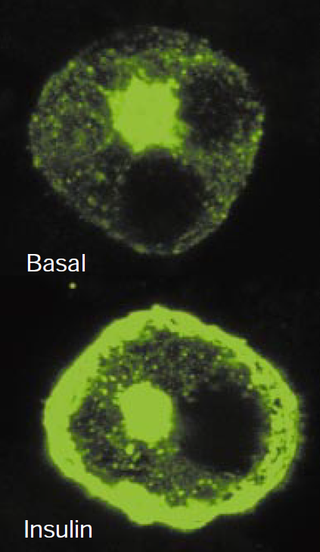
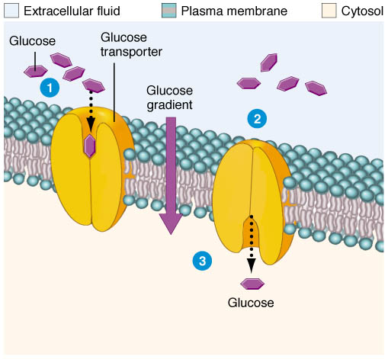
Glucose Uptake
Passive Glucose Uptake
Stimulated Glucose Uptake
Brain
Liver
Kidneys
Fat
Muscle
GLUT4-eGFP
From Saltiel and Kahn (2001) Nature 414:799-806
From http://classroom.sdmesa.edu/eschmid/Chapter3-Zoo145.htm

Slide 19
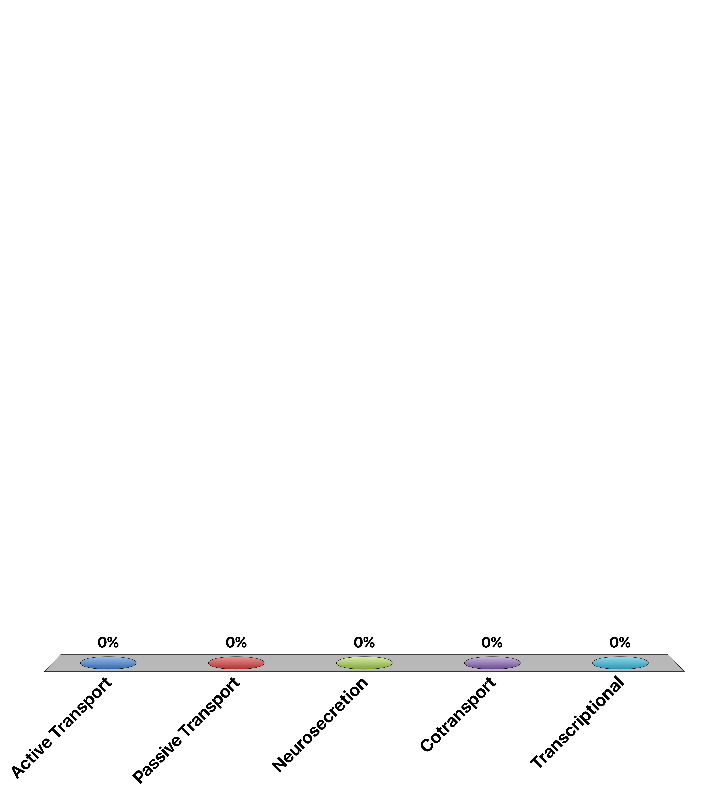
GLUT4 Mediated Glucose Uptake Is
Active Transport
Passive Transport
Neurosecretion
Cotransport
Transcriptional

Slide 20
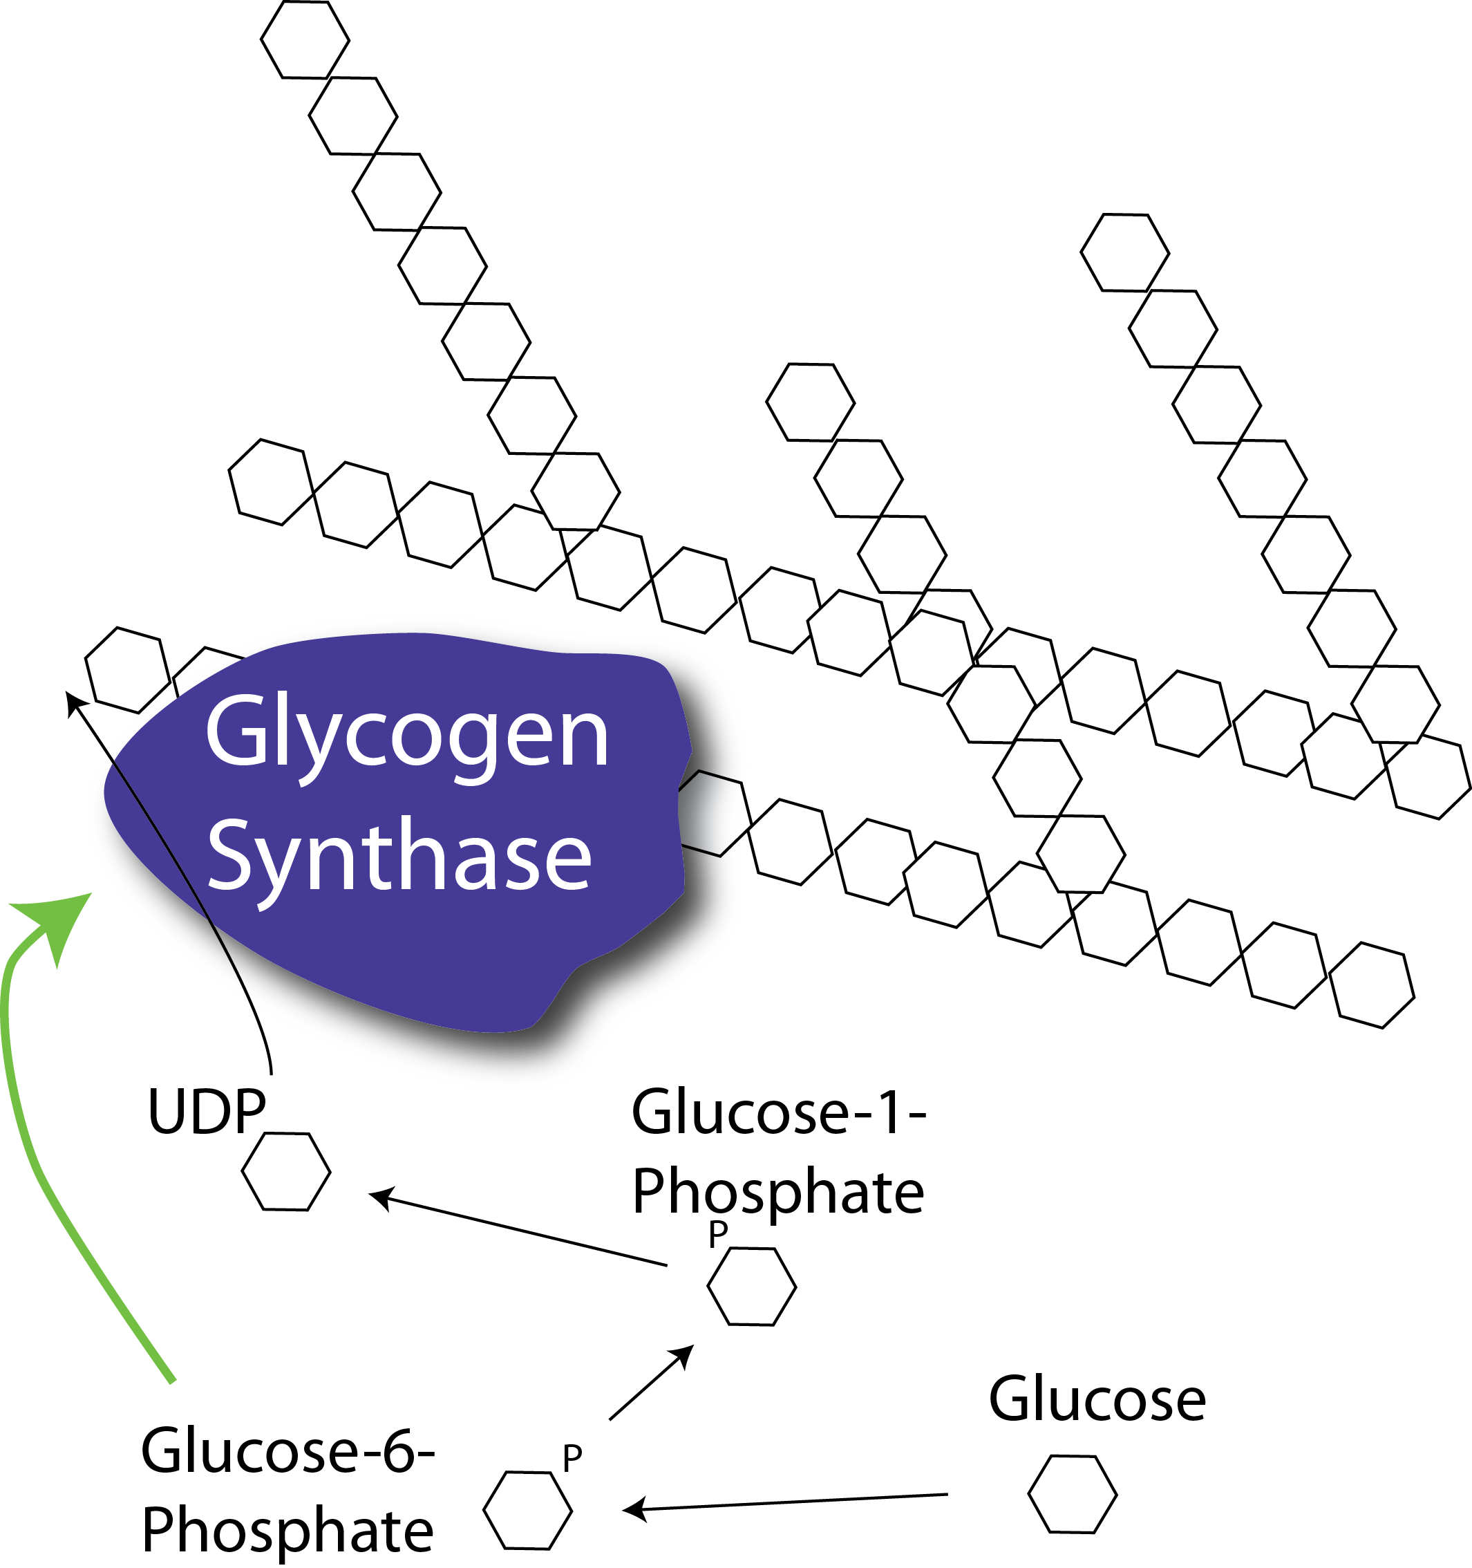
Glycogenesis
Notes:
Rate limiting step is the regulation of glycogen synthase activity.
Allosterically activated by Glucose-6-Phosphate, which is increased during glucose uptake and glycolytic flux

Slide 21
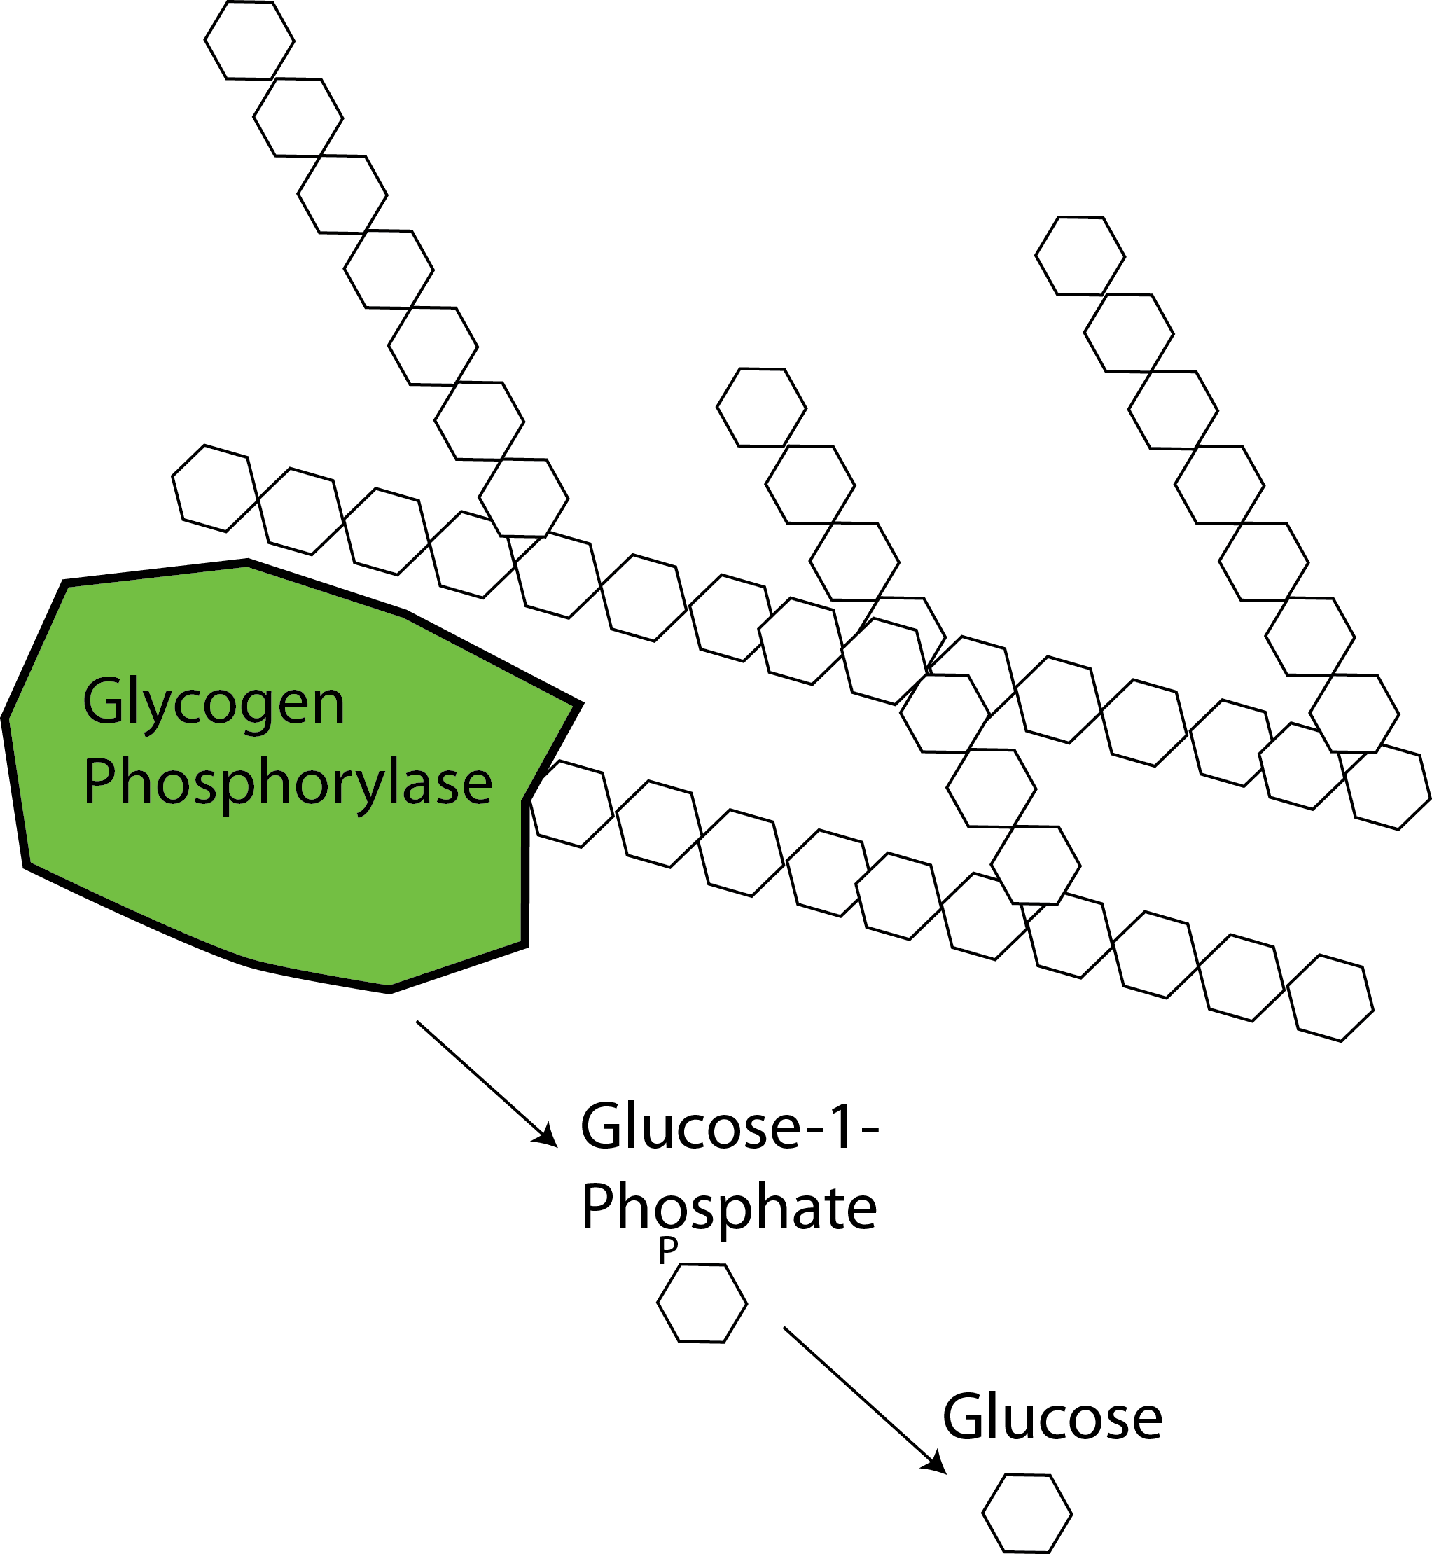
Glycogenolysis

Slide 22
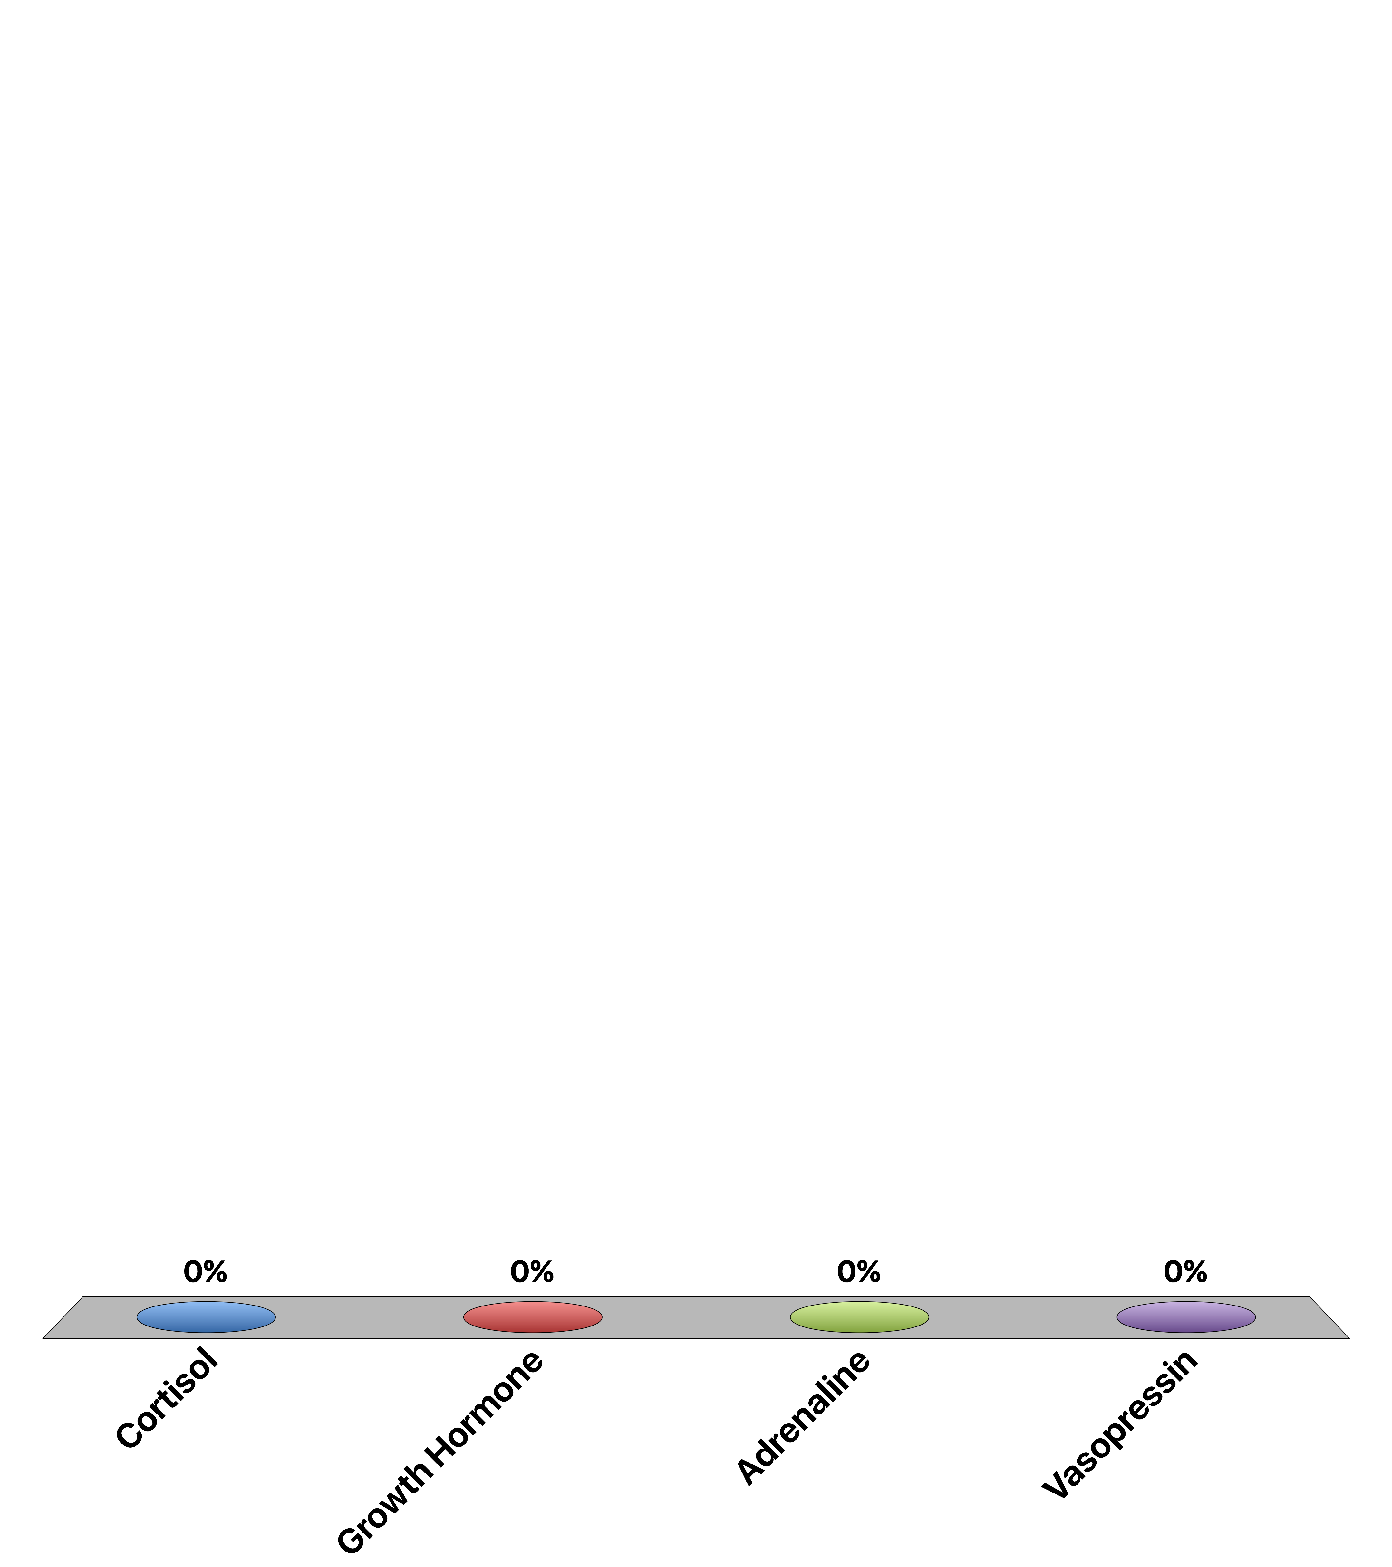
What hormone, other than glucagon activates glycogenolysis via PKA
Cortisol
Growth Hormone
Adrenaline
Vasopressin

Slide 23
Mechanisms to Reduce Blood Glucose

Slide 24

Functions of Insulin
Promotes the uptake of glucose from the blood into muscle and adipose tissue.
Enhances the synthesis of glycogen and triglycerides in liver, adipose and muscle.
Insulin inhibits gluconeogenesis, or the production of glucose from non-glucose precursors such as amino acids and lipids.
Promote glucose breakdown and prevent lipid breakdown
Food
Circulating
Nutrients
(Glucose)
Glucose Production
Glucose Disposal
Insulin
Secretion
Nutrient Storage

Slide 25
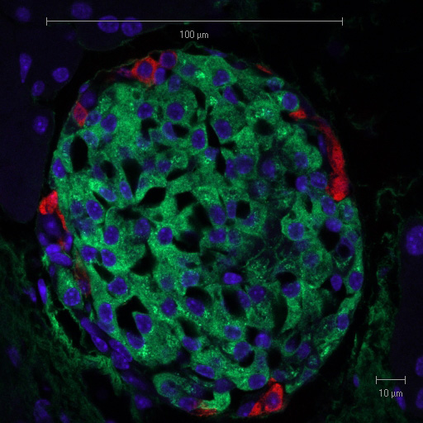
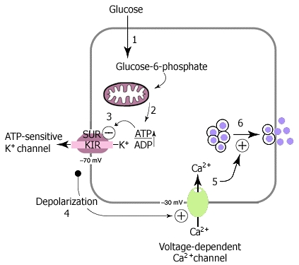
Insulin Secretion
Suckale and Solimena (2008) Frontiers in bioscience 13:7156-71
Pancreatic Islet with Glucagon and Insulin Staining
From Solilema Lab (http://en.wikipedia.org/wiki/Islets_of_Langerhans)
Notes:
Red is glucagon, green is insulin
What happens if you cannot secrete insulin from beta cells?

Slide 26
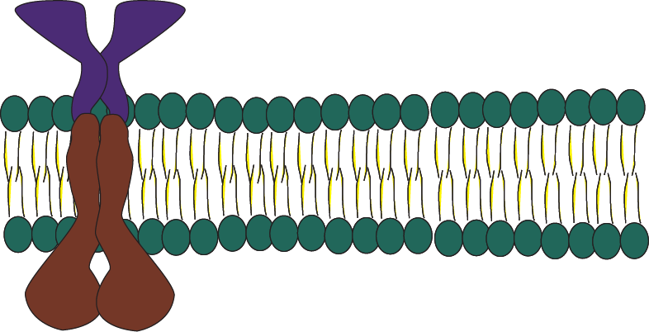
Insulin Signaling – PI3K Signaling
Insulin
P
P
IRS
PI(4,5)P₂
PI(3,4,5)P₃
p85
P
P
P
p110
P
P
P
Class I PI3K

Slide 27
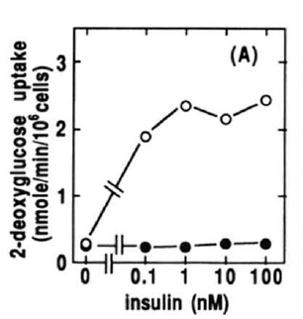
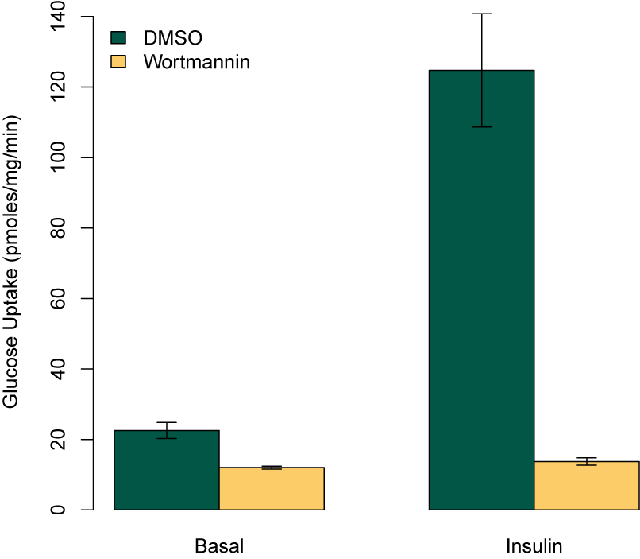
Key Role of PI3K in Insulin Signaling
Kanai et al (1993) Biochem Biophys. Res. Comm. 195:762:768

Slide 28
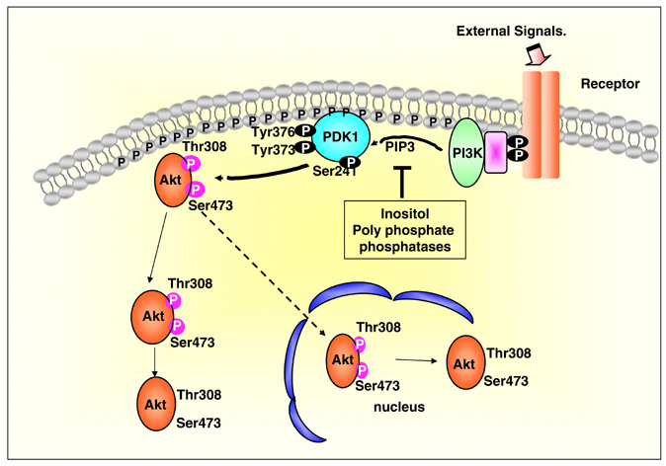
Akt Activation by the PI3K Pathway
mTORC2
Notes:
Virtually all relevant insulin signaling requires the activation of Akt
Make sure to mention that all of these phosphorylation events can be reversed by protein phosphatases

Slide 29
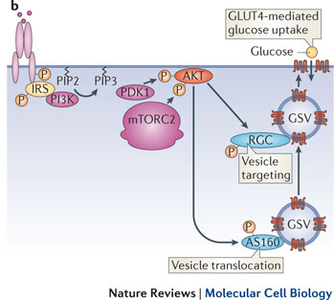
Insulin Stimulated GLUT4 Translocation
Leto and Saltiel Nat. Rev. MCB (2012)

Slide 30
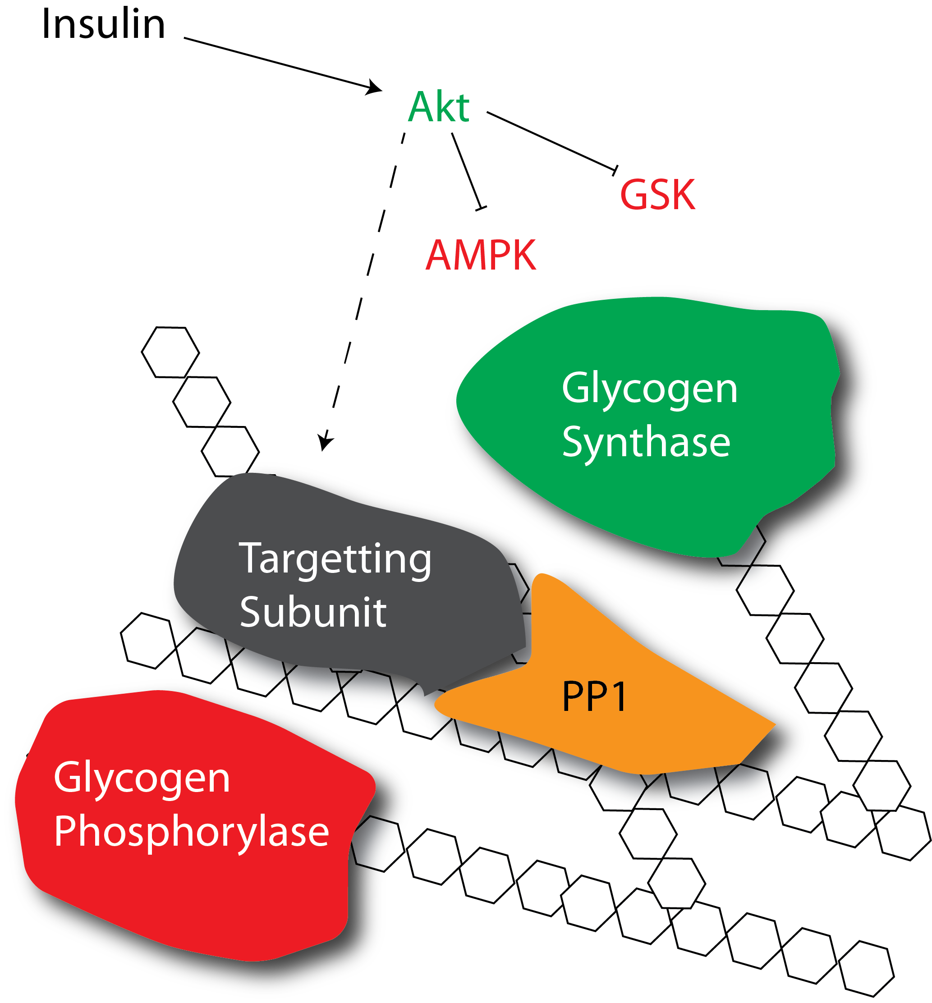
How does insulin promote glycogenesis?
Allosteric activation
Protein dephosphorylation
Notes:
First ask about which mediators are increased with insulin, or see what the allosteric activation of GS looks like

Slide 31
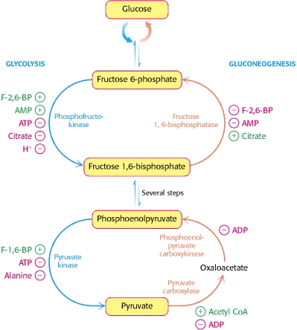
How does insulin reduce gluconeogenesis
FBPase is negatively regulated by F-2,6-BP
PEPCK and G6Pase are inhibited by insulin
Allosterically
Protein phosphorylation
Transcriptionally repressed
Notes:
First, does insulin promote or reduce gluconeogenesis

Slide 32
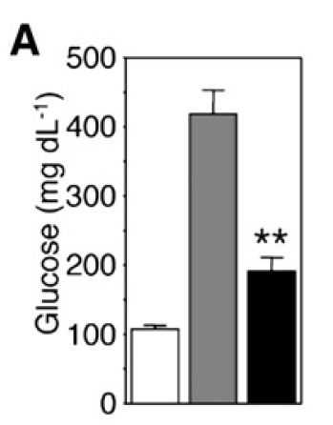
Transcriptional Regulation of Gluconeogenesis
Akt
PEPCK
G6Pase
P
Knockout
IR
IR +
FOXO
FOXO
P
P
Matsumoto et al. (2007) Cell Metab. 6:208-16

Slide 33
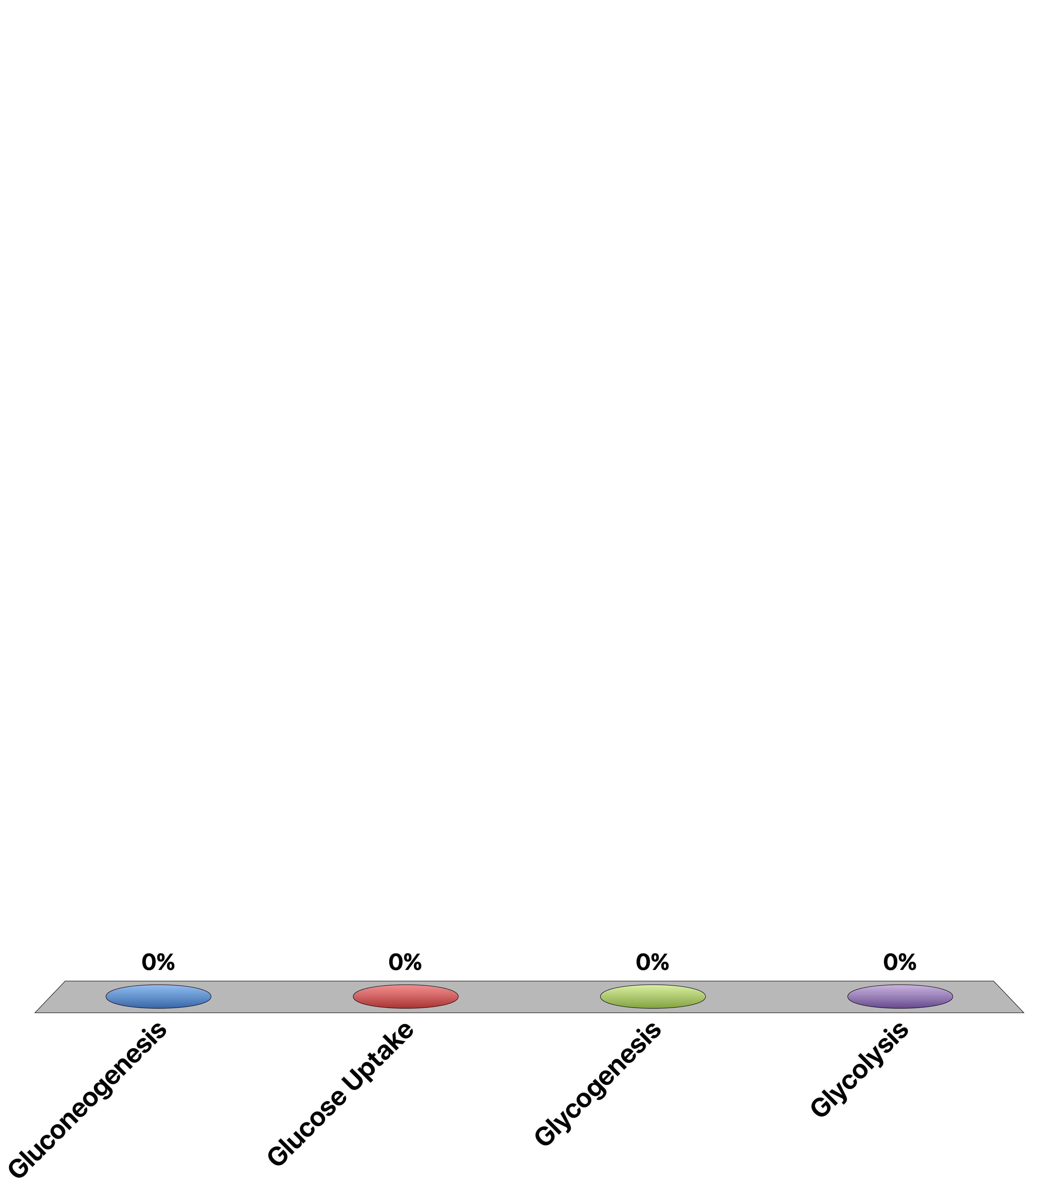
What does insulin NOT activate?
Gluconeogenesis
Glucose Uptake
Glycogenesis
Glycolysis
Response Counter
15

Slide 34
Mechanisms to Increase Blood Glucose

Slide 35
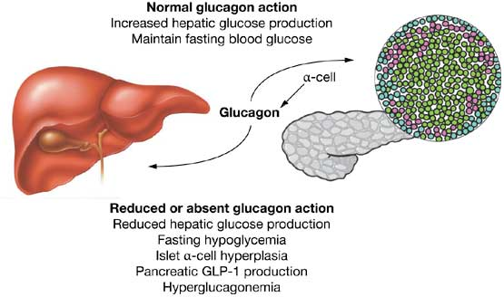
Glucagon Secretion
Secreted from alpha cells of the pancreas
Released by low blood sugar levels
Acts on the liver not the muscle or fat tissues
Drucker (2013): Nat Rev Endo 1:22-31

Slide 36
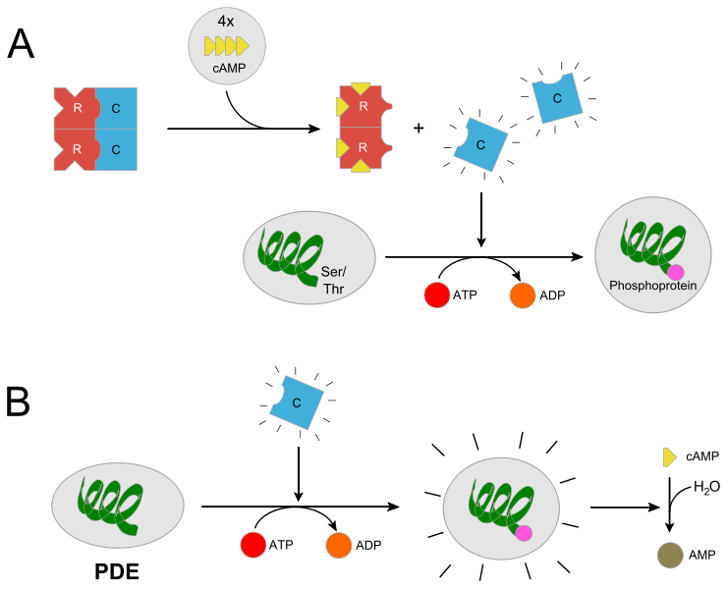
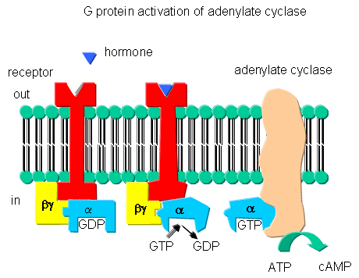
Glucagon Signaling
From http://biowiki.ucdavis.edu/Biochemistry/Signal_Transduction/Signal_Transduction_at_Cell_Membranes%3A_Protein_Kinases_and_Phosphotases
From http://en.wikipedia.org/wiki/Protein_kinase_A
Notes:
Potentially spend some time on earl sutherland’s experiments

Slide 37
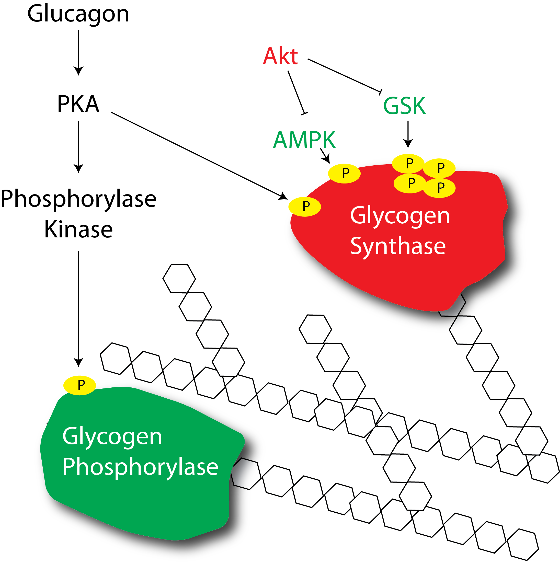
How does glucagon regulate glycogenolysis?

Slide 38
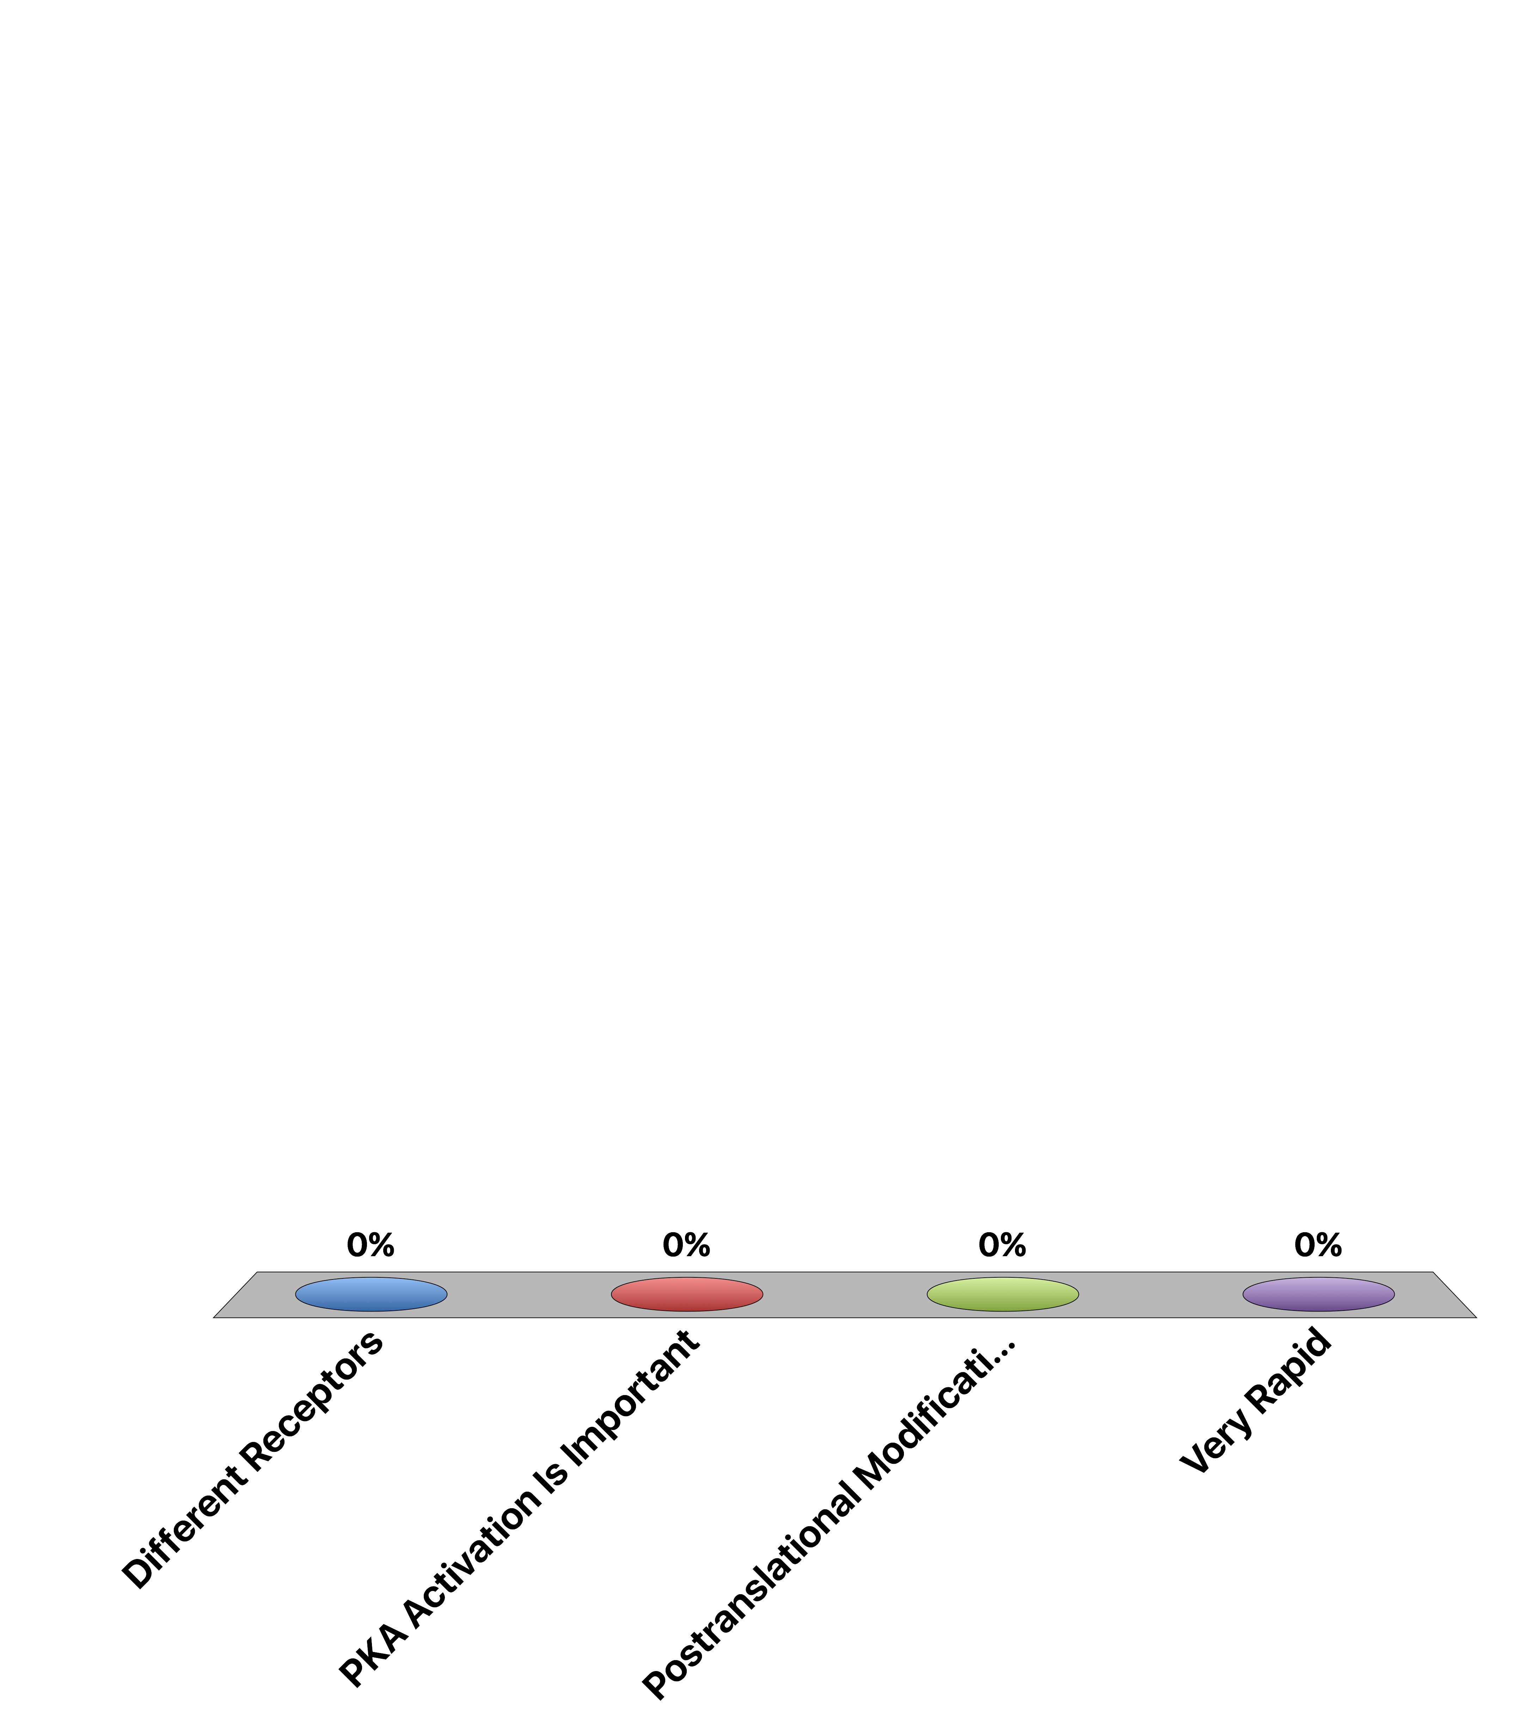
What is different between glucagon and adrenaline induced glycogen breakdown?
Different Receptors
PKA Activation Is Important
Postranslational Modifications
Very Rapid

Slide 39
How does glucagon promote gluconeogenesis?
PKA
PFK-2
Notes:
Same as epinephrine
Ask, if we modulate F26P to promote gluconeogenesis, what would we want to do to it

Slide 40
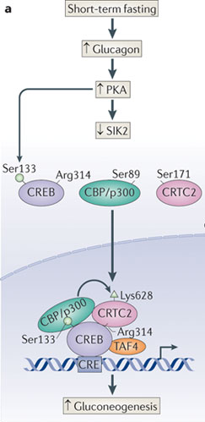
Transcriptional Regulation of Gluconeogenesis
More G6Pase, FBPase and PEPCK
Altajeros and Montminy (2008) Nat. Rev. MCB. 3:141-151

Slide 41
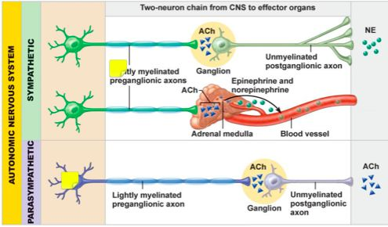
Nervous Control of Pancreatic Function
More Glucagon
Less Insulin
More Insulin
Less Glucagon
Notes:
Independent of blood glucose, what would exercise do to insulin and glucagon levels

Slide 42
Glucose and Hormones After a Meal
First glucose goes up (due to the food)
Then insulin increases (in response to glucose)
This causes glucose levels to drop
At the same time glucagon levels will decrease as glucose levels are high, then increase as normoglycemia is maintained
Notes:
Draw a GTT on the board

Slide 43
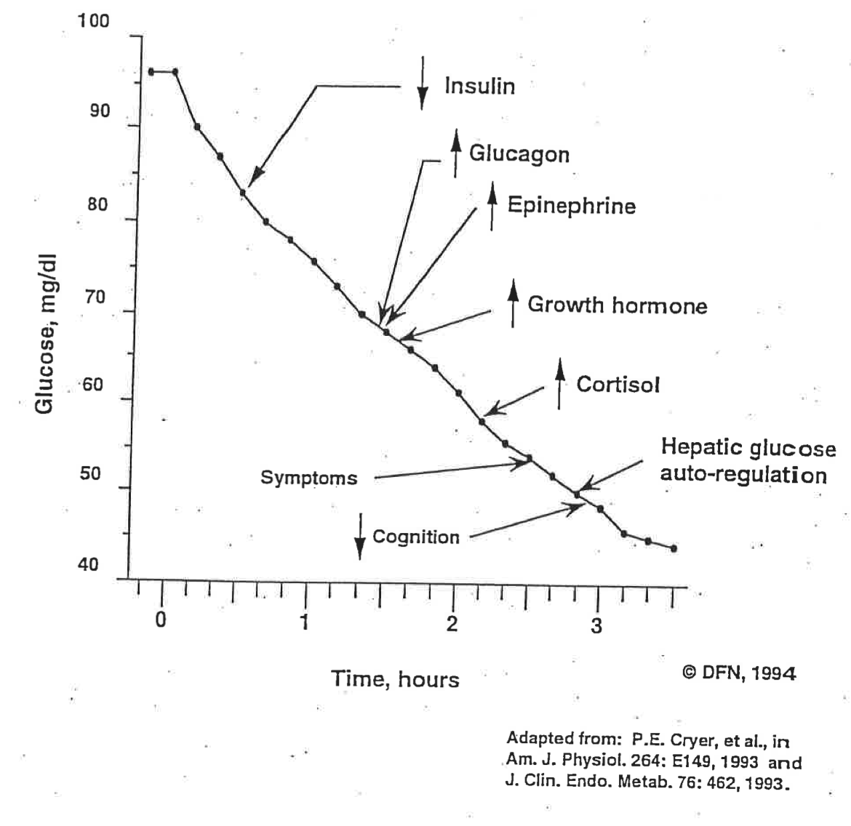
Long Term Glucoregulation

Slide 44
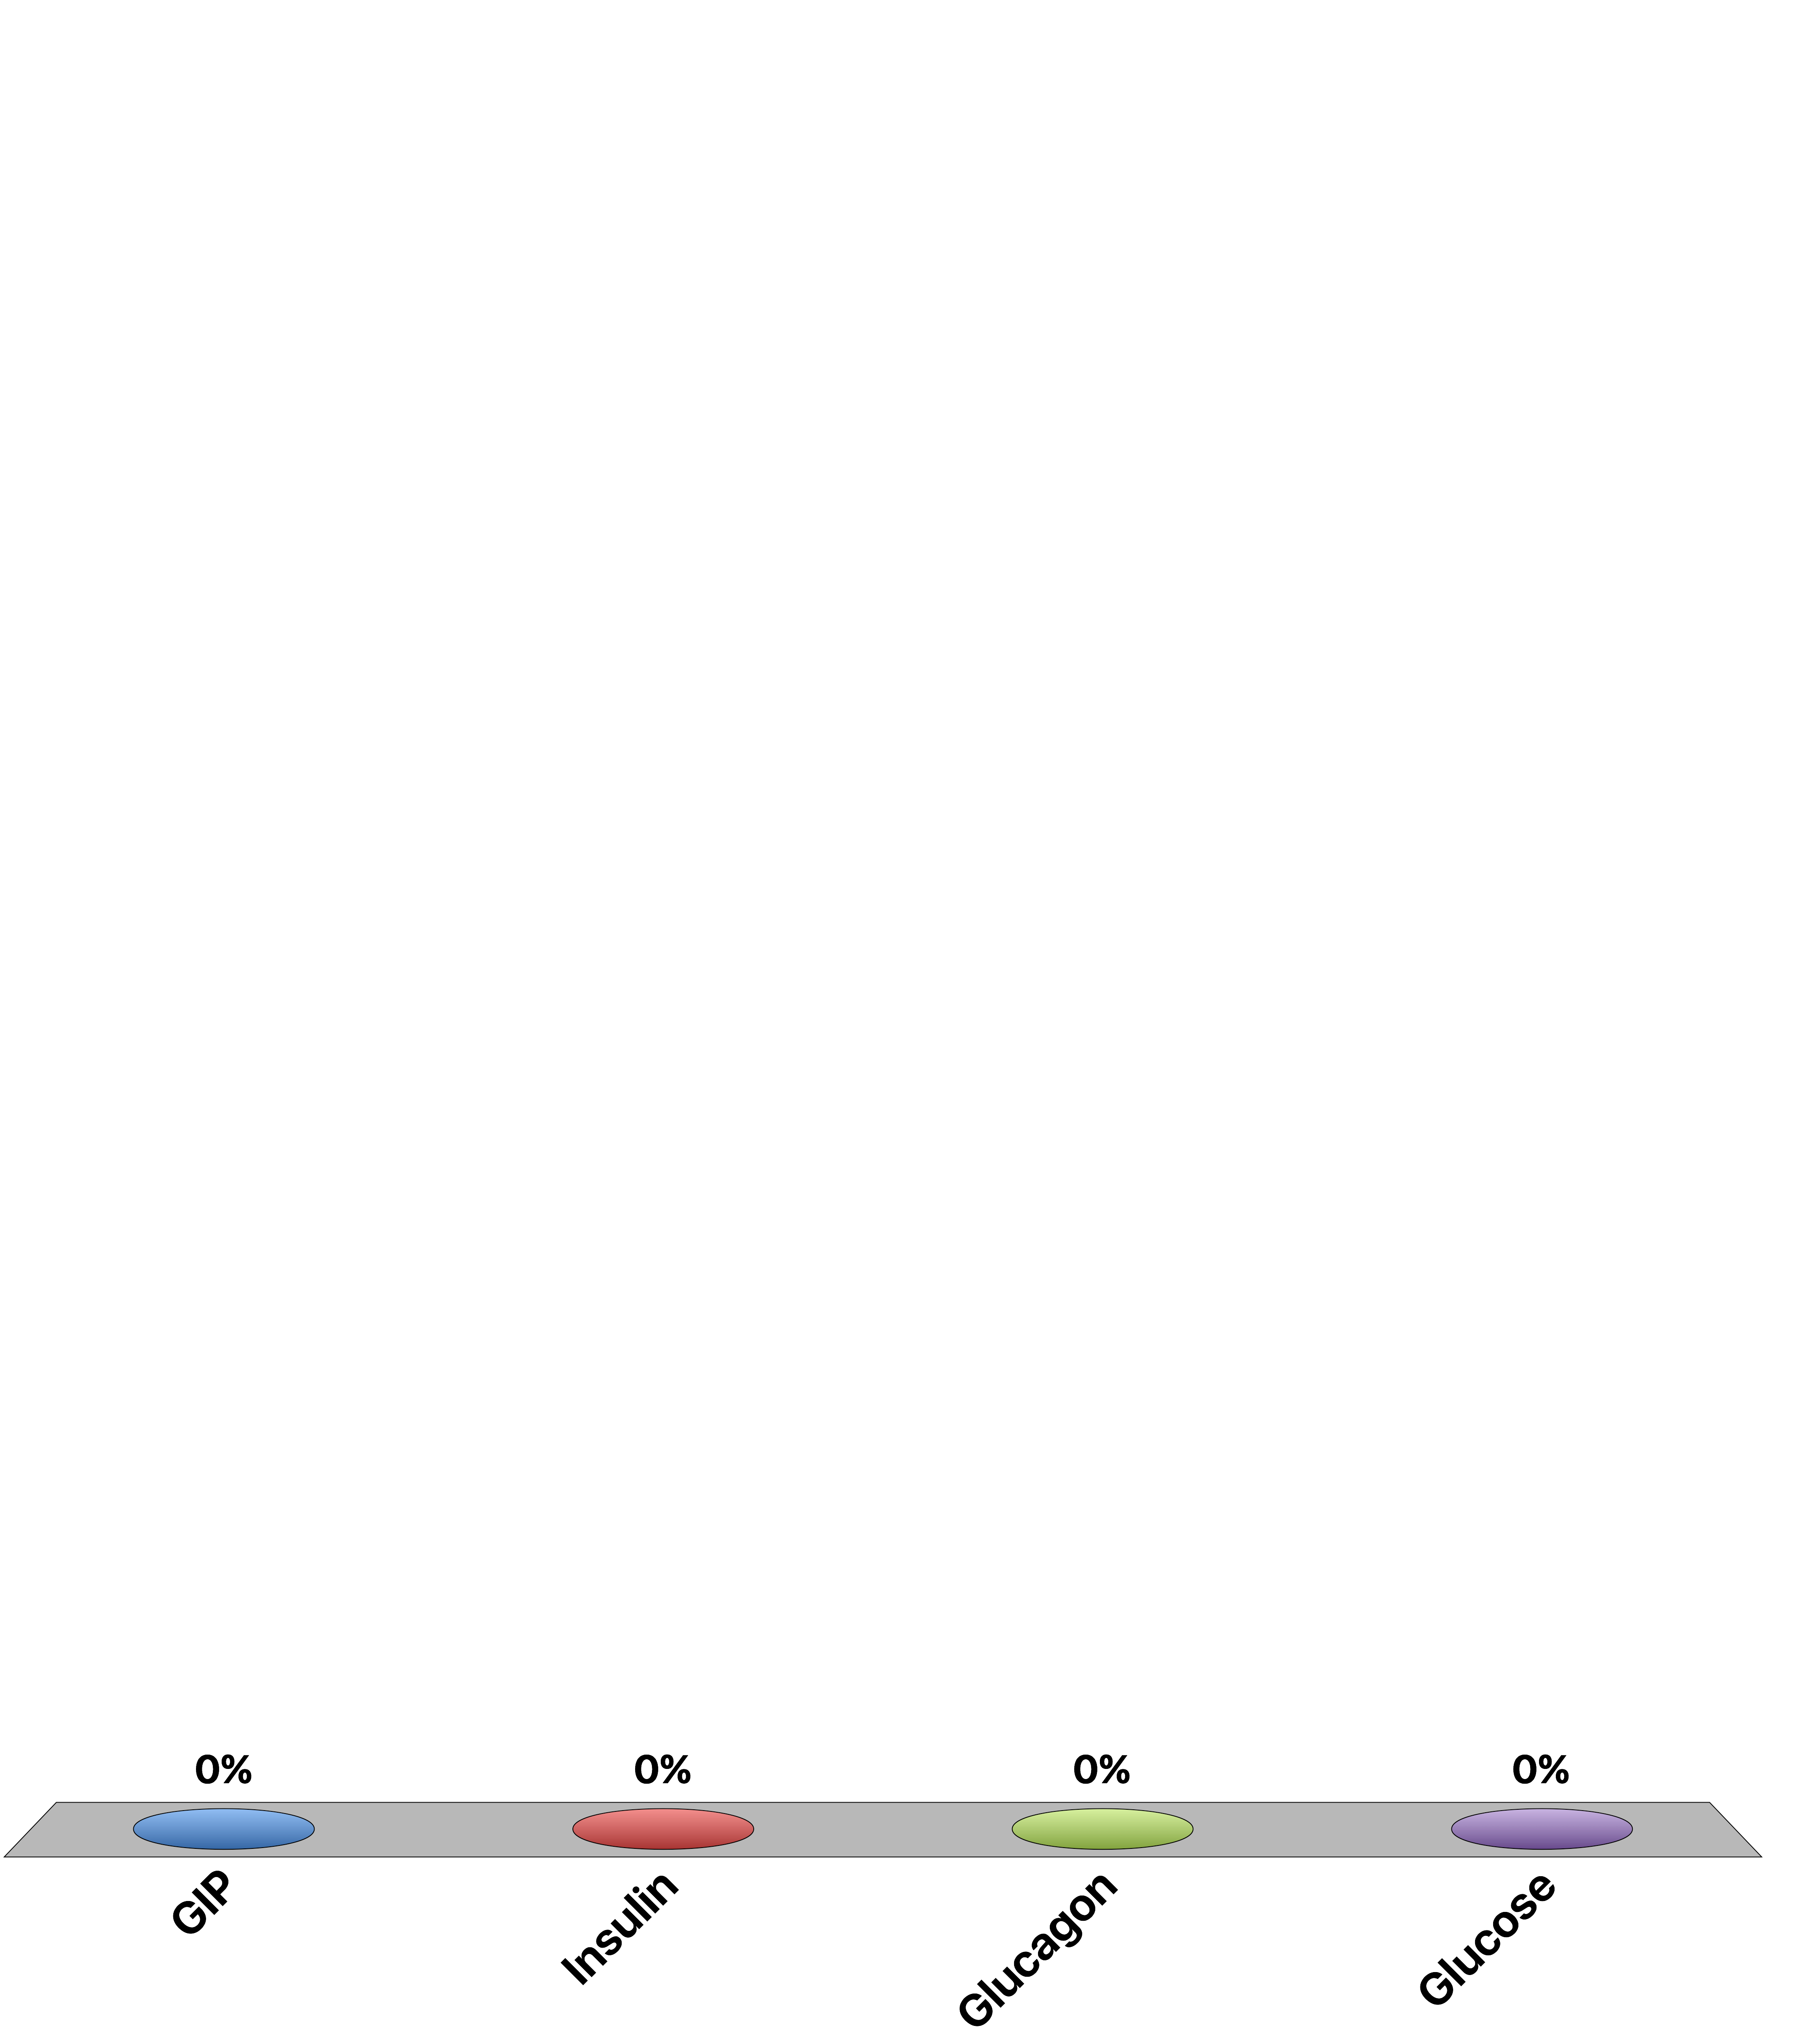
During Fasting Which Is Elevated
GIP
Insulin
Glucagon
Glucose
Response Counter
15
Notes:
C is correct

Slide 45
Pathophysiology of Glucose Control

Slide 46
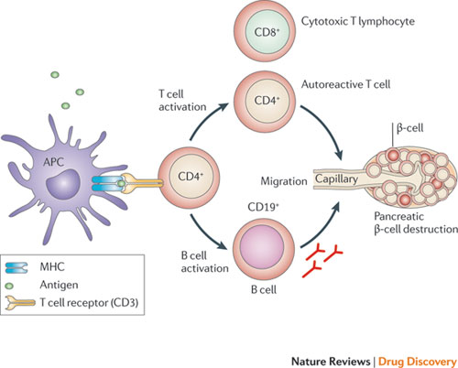
Type I Diabetes Results from a Loss of Beta Cells

Slide 47
Type II Diabetes
Excessive nutrient storage
Tissues Become Insulin Resistant
Pancreas Compensates by Secreting More Insulin to Normalize Glucose
Tissues Become More Insulin Resistant
Eventually Pancreas Fails to Compensate
Hyperglycemia

Slide 48
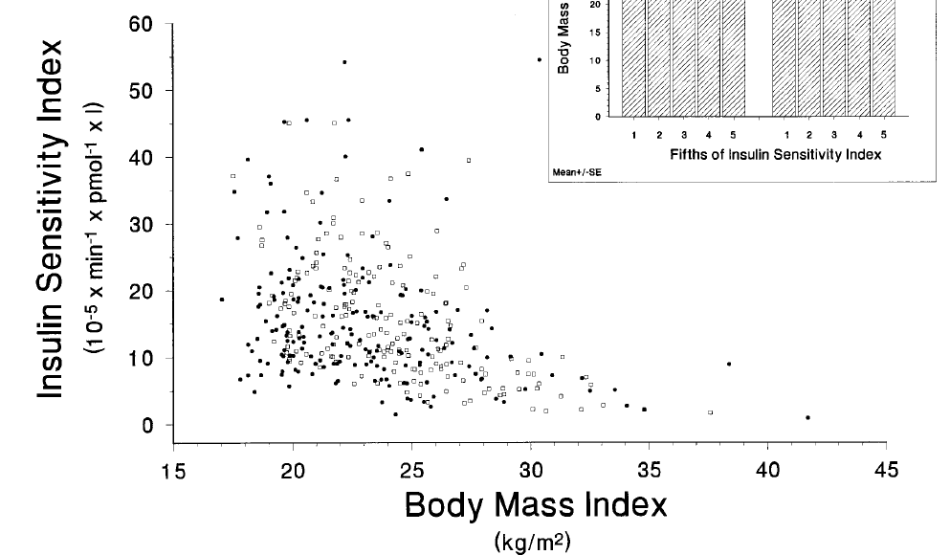
Why Is There Insulin Resistance
Negative feedback loops are common in most endocrine organs
A mechanism to avoid excessive nutrient storage
The “Thrifty Genotype” Hypothesis
Clausen et al. 1996 J. Clin. Invest. 98:1195–1209
Notes:
Spend some time discussing what would happen Insulin resistance and pancreatic responses underlie progression from weight gain to diabetes
if someone is obese but resistant to diabetes

Slide 49
Discuss Amongst Yourselves
Why is giving insulin “effective” for type 2 diabetes?
Why is it a poor long-term solution?

Slide 50
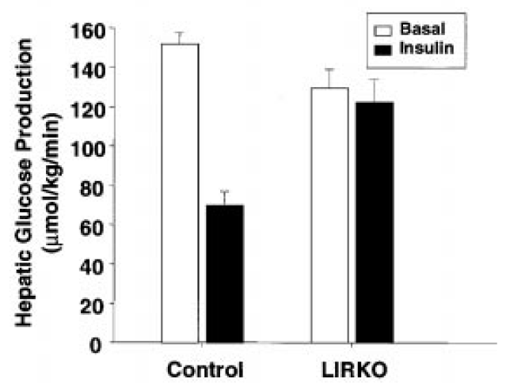
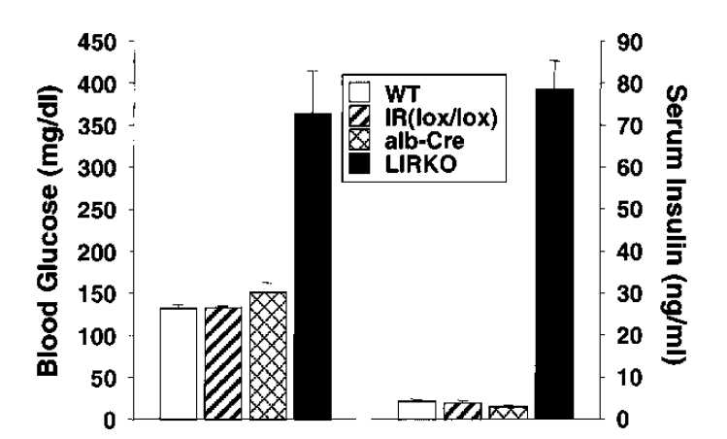
Liver Insulin Receptor Knockout
Michael et al. (2000) Mol Cell 6:87-97

Slide 51
Mechanisms of Insulin Resistance
Overnutrition induced insulin resistance
Lipid mediated insulin resistance
Inflammation associated insulin resistance

Slide 52
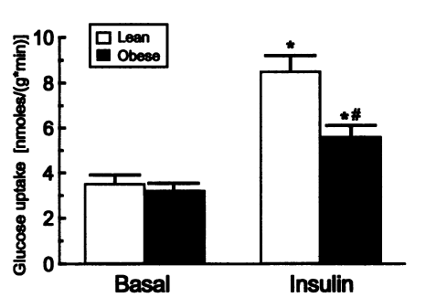
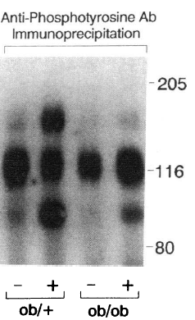
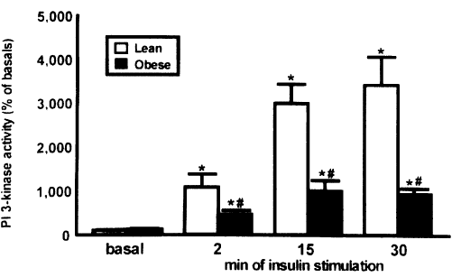
Molecular Mechanisms of Insulin Resistance
Saad et al. (1992)
J. Clin. Invest. 90:1839–1849
Goodyear et al. (1995) J Clin Invest 95: 2195-204
Notes:
If PI3K activity is decreased, what upstream problems could cause that?

Slide 53
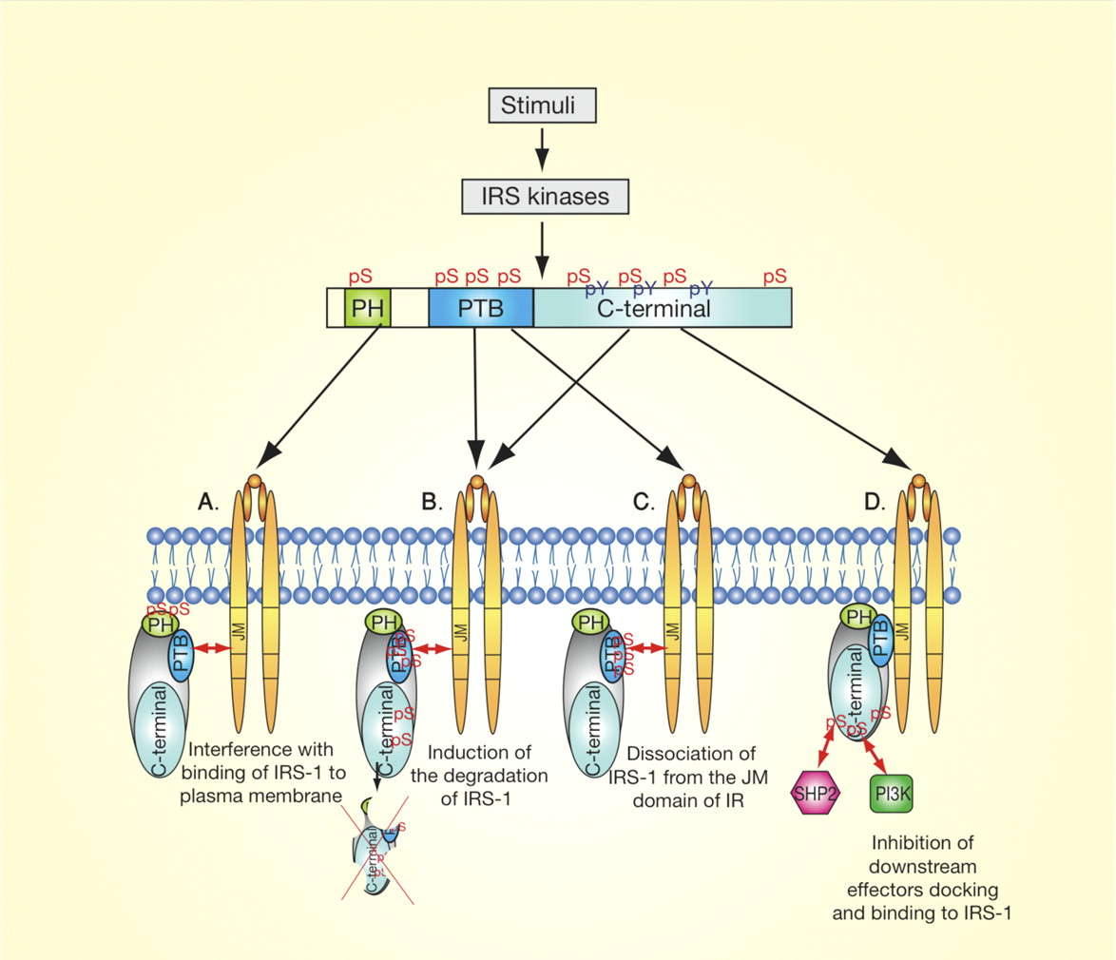
IRS Serine Phosphorylation
Boura-Halfon and Zick (2009) Am. J. Endo. Metab. 296:E581-E591

Slide 54
Learning Objectives
Name the cell types of the Islets of Langerhans and name the hormones secreted by them.
Describe the main targets and functions of glucagon.
List the major factors that stimulate or inhibit glucagon and insulin.
Describe the important physiological roles of insulin.
List the major actions of insulin in muscle, adipose tissue, and liver.
Explain briefly the mechanism of glucose uptake into the muscle.
Name the tissues in which insulin facilitates glucose uptake and those in which insulin does not facilitate glucose uptake.
List the major factors that stimulate or inhibit insulin secretion.
Draw an oral glucose tolerance test (oGTT) (glucose, insulin, and glucagon levels) and and describe what is occurring and why. Explain how the two hormones act to promote glucose homeostasis in the plasma.
State which nutrient storages are preferably used for short-term regulation of energy metabolism if no nutrients are available from the GI tract.
Discuss the hormones involved, fuel storage capacity, fuel storage consumption, and glucose (or fatty acid) levels during 1) the postprandial period, 2) the post-absorptive period, 3) fasting.
List the insulin-counteracting hormones and their roles in glucose homeostasis. Discuss the hormones involved in minute-to-minute regulation and long-term regulation of glucose homeostasis.

Slide 55
Regulation of Appetite

Slide 56
Learning Objectives
Describe the appetite-regulating hormones secreted from the gut, how they are regulated and under what conditions they are released.
Describe the AgRP/POMC circuit and its relationship to both circulating factors and neuropeptides.
Understand the relationship between adipose mass and appetite regulation, including how adipokines are regulated and what role they play.
List the effects of insulin on appetite and what the neurological targets of insulin are.
Describe the role of the blood-brain barrier in the regulation of appetite and how it is altered in obesity.
Describe how hypothalamic feeding circuits integrate with other pleasure and reward circuits in the brain.
Explain how neuroendocrine obesity differs from idiopathic obesity and how they might be treated in different ways.

Slide 57
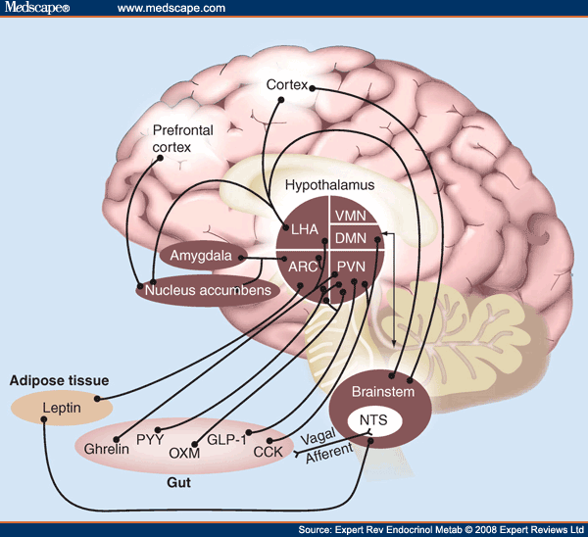
The Central Role of The Hypothalamus

Slide 58
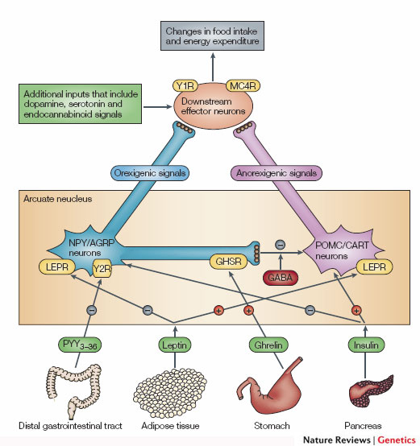
The POMC/AgRP Circuit
Promotes
Eating
Suppresses
Appetite
Notes:
Two populations of neurons in the arcuate nucleus.

Slide 59

Activation of AGRP Neurons is Sufficient to Promote Hunger
Aponte Y, Atasoy D, Sternson SM. AGRP neurons are sufficient to orchestrate feeding behavior rapidly and without training. Nat Neurosci 2011; 14:351–5.

Slide 60

Glucose Sensing Neurons
AgRP
POMC
Notes:
In the subfornicular organ, area postrema and the hypothalamus

Slide 61

Hormonal Control of Appetite
Notes:
Think about it this way… AgRP neurons like to be on, and when they are on they increase appetite.

Slide 62
Insulin Regulation of Appetite
Acts on both AgRP and POMC Neurons
Enhances excitability of POMC but inhibits AgRP Neurons -> Decreases appetite
Requires transport across blood-brain barrier
What would insulin resistance in the brain do to appetite?
Notes:
anorexigenic

Slide 63


Leptin and the Ob/Ob Mouse
ob/ob mouse
db/db mouse

Slide 64
The Leptin/Leptin Receptor Genes
Leptin
Receptors in
Hypothalamus
Reduced
Food
Intake
Leptin
Release
Notes:
ob gene is leptin
db gene is the leptin receptor

Slide 65
Leptin Summary
What chemical type? | Protein
Where is it made? | Adipocytes
What causes its release? | Fat Expansion
What are its receptors? | LepR (JAK/STAT)
What tissues does it affect? | Brain | Activates POMC, Inhibits AgRP -> Reduced Food Uptake
 | Adipose, Liver, Muscle | Fat Oxidation
How does it get turned off? | Receptor desensitization, reduced BBB transport
Notes:
Talk about negative feedback and why leptin therapy dosent work

Slide 66

A person with no Leptin Receptor
Would over-eat because it cant respond to leptin
Would not eat because it cant respond to leptin
Would over-eat because it responds too strongly to leptin
Would not eat because it responds too strongly to leptin
Response Counter
15

Slide 67

Ghrelin, the Hunger Hormone

Slide 68
Ghrelin Summary
Where is it made? | Protein
What causes its release? | Less Stomach Stretch
What are its receptors? | GHSR (Gq-GPCR) | AgRP Neurons
What tissues does it affect? | Brain | Inhibits AgRP-> Increased Food Intake
How does it get turned off? | Receptor desensitization, reduced BBB transport, food intake -> stomach stretch
Notes:
Talk about negative feedback and why leptin therapy dosent work

Slide 69

PYY

Slide 70
PYY Summary
Where is it made? | PYY
What causes its release? | Nutrients in Colon
What are its receptors? | Y1R | AgRP/POMC Neurons
What tissues does it affect? | Brain | Increased Food Intake
 | GI Tract | Smooth Muscle Contraction (GI Motility)
How does it get turned off? | Receptor desensitization, food moves out of GI
Notes:
Talk about negative feedback and why leptin therapy dosent work

Slide 71
Obesity and the BBB
Leptin, Ghrelin and Insulin transport is reduced.
PYY and Adrenaline permeability is not reduced

Slide 72
Monogenic Forms of Obesity
Gene | Function | Incidence
LEP | Leptin -> Reduces Appetite | Rare
LEPR | Leptin Receptor | 2-5% of obese individuals
POMC | MSH/ACTH | Rare
MC4R | MSH Receptor | 2-5% of obese individuals
BDNF | Downstream of MC4R | Rare
NTRK2 | BDNF Receptor | Rare
How could a leptin deficient patient be treated that might be different from how a idiopathically obese patient is treated?

Slide 73

Which hormone stimulates appetite
Insulin
Leptin
Ghrelin
PYY
Response Counter
15

Slide 74
Learning Objectives
Describe the appetite-regulating hormones secreted from the gut, how they are regulated and under what conditions they are released.
Describe the AgRP/POMC circuit and its relationship to both circulating factors and neuropeptides.
Understand the relationship between adipose mass and appetite regulation, including how adipokines are regulated and what role they play.
List the effects of insulin on appetite and what the neurological targets of insulin are.
Describe the role of the blood-brain barrier in the regulation of appetite and how it is altered in obesity.
Describe how hypothalamic feeding circuits integrate with other pleasure and reward circuits in the brain.
Explain how neuroendocrine obesity differs from idiopathic obesity and how they might be treated in different ways.

